Slide 1
A day of a solar panel
March

Slide 2
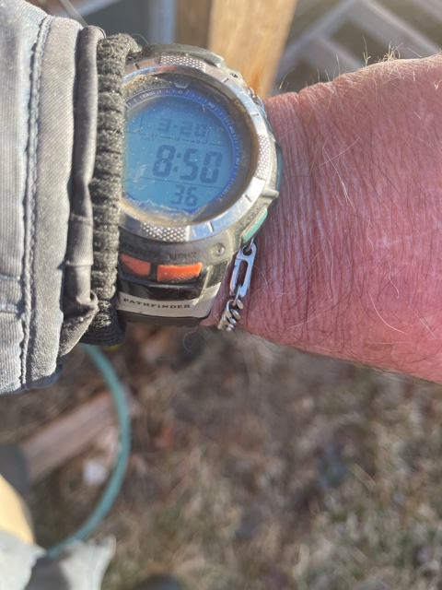
March 20th 2021 at 8:50 am. Checking on a 230 watt pv panel

Slide 3
the seasonal Sun

Slide 4
The sun hits the tropic of cancer and tropic of capricorn

Slide 5
The latitude of Toronto, ON, Canada is 43.651070, N

Slide 6
Angles through the seasons to catch the sun

Slide 7
The pv panel is a 230 watt panel mounted on a wall at about a 45 degree angle

Slide 8
As seen on the label, the panel
Is rated 230 watt give or take 3 percent.
The open circuit voltage is rated at 36.6 volt dc and the short circuit current is 8.37 Amp.
This presentation will go through the day until 1 pm when the sun is starting to deplete its influence..
The sun rises in the East but the sun arcs across the sky south from east to west,. The morning sun is the weakest and the western sky still has a bit of life in it … we are located approx 44 degrees north of the equator so our sun strength is not as it would be at the equiator due to the arc and distance from the sun

Slide 9
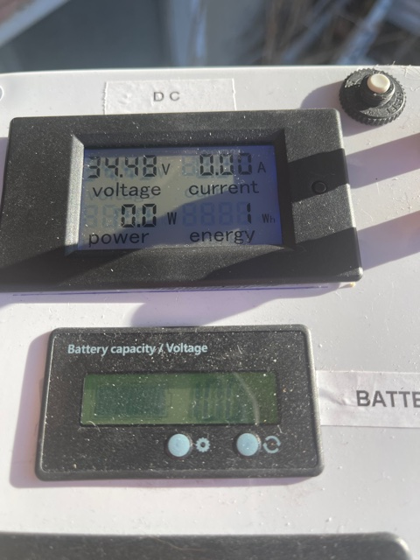
The voltage reading at this time is reading 34.48 volts open circuit which means no load is on it

Slide 10
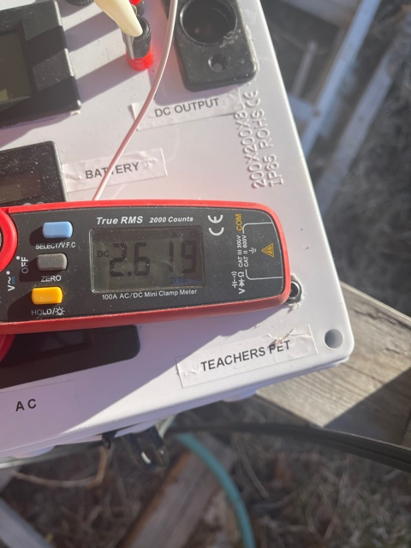
The short circuit current as shown is reading 2.6 amp… this means that the output leads are shorted together to give highest reading that the panel can give at a given time.
NOTE: the meter used is a clamp on ampmeter.

Slide 11
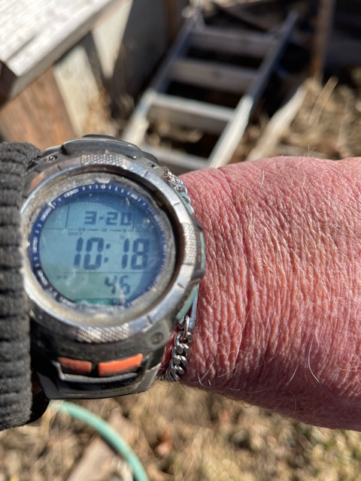
This reading was done at 10:18 am on the same day.

Slide 12
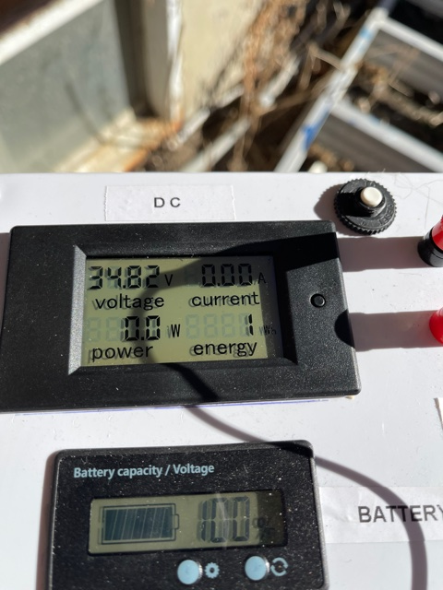
The open voltage is at 34.82 volts, so the voltage is marginally more than at 9 am reading.

Slide 13
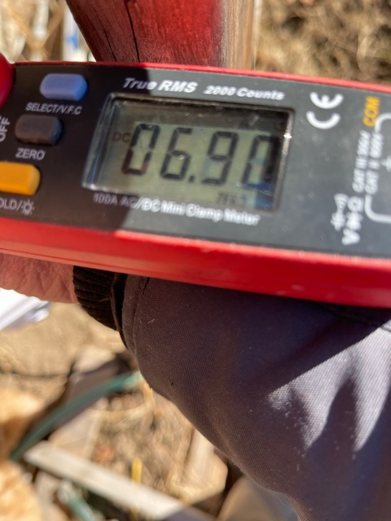
The current is now at 6.90 amp
Up from 2.6 amp one hr earlier.
Keep in mind that this 230 watt panel is rated nominal 24 volt which relates to approx . 9.58 am at the best of times under ideal conditions.

Slide 14
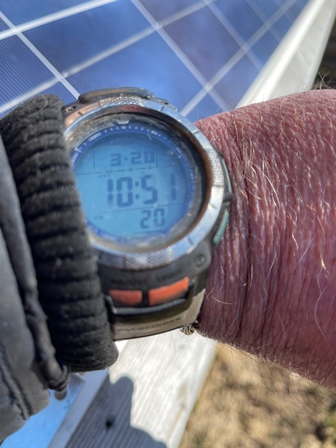
The time now is 10:51 am.

Slide 15
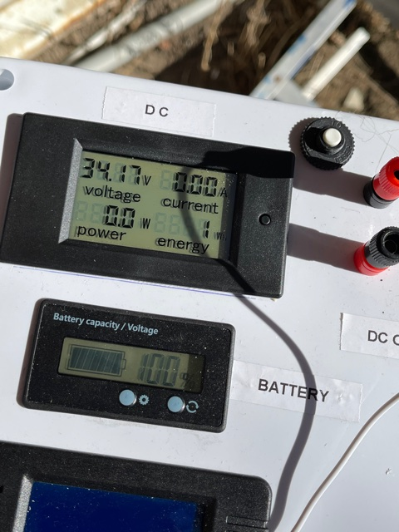
The voltage is sitting at about 34.17 volt DC which is a slight drop..

Slide 16
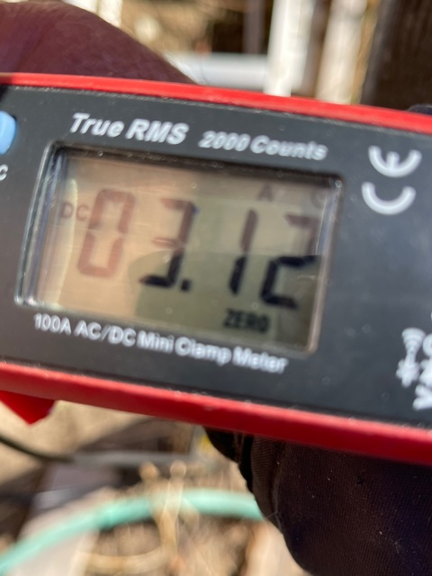
The current is now at 3.12 amp.. Which is a drop to almost half.. But why???

Slide 17
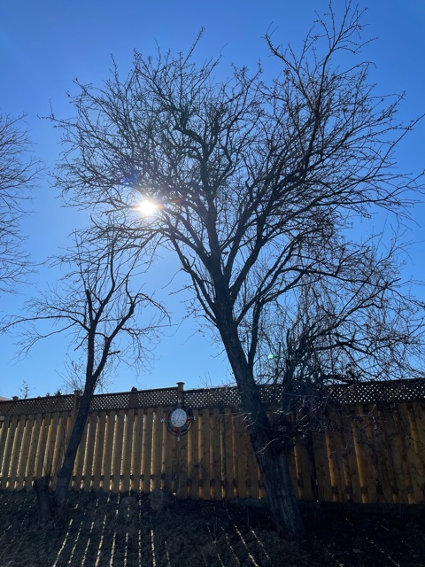
As shown, the sun is partially covered by the branches of the trees which block the photons.. In the next picture, you will see the shadows on the panel

Slide 18
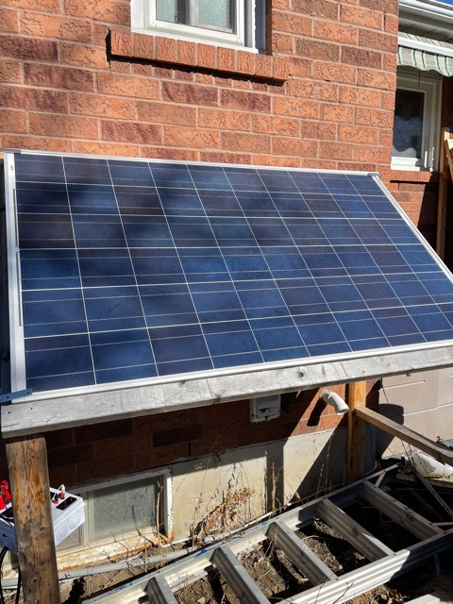
Does not take much., the next picture shows it a bit better.

Slide 19
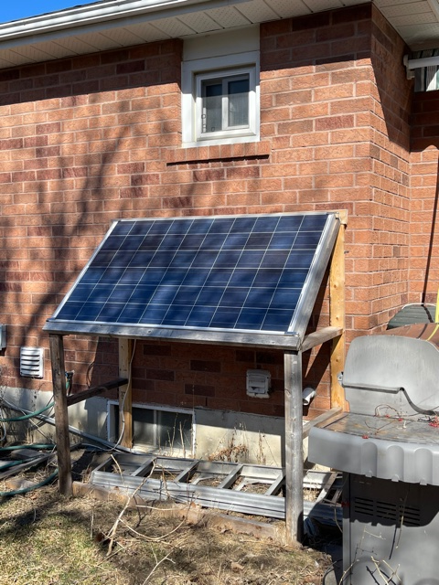
If the panel was placed on the roof, it may result in collecting more photons.., so since we have another panel in a slightly different location,, we will move to that panel for readings

Slide 20
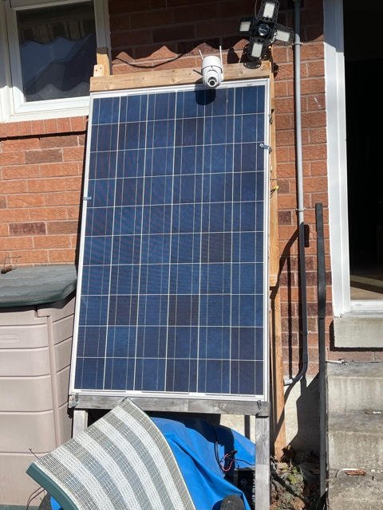
This is also a 230 watt panel but there is no shade on this panel at this time.

Slide 21
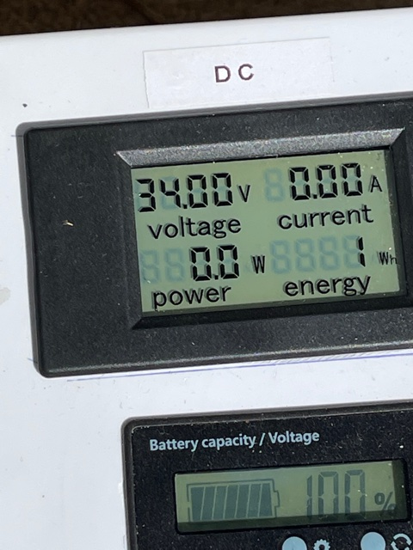
The voltage is at 34 volt which seems to be a bit less than the other panel but lets look at the current.

Slide 22
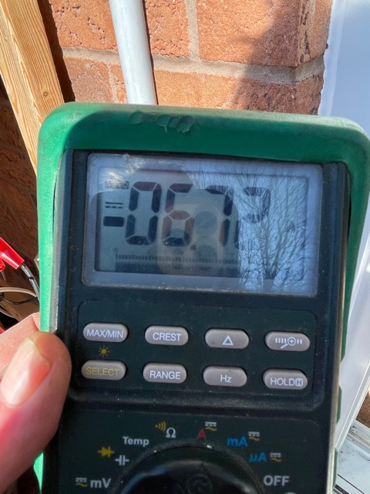
The current is at 6.72 amp instead of the 3 something amp with the panel in the shade., there may be a difference because both panels are not at the same angle, this panel is sitting about 20 something degree angle due to the amount of space I was working with.. Again, I could get full current or at least much more if mounted on the roof

Slide 23
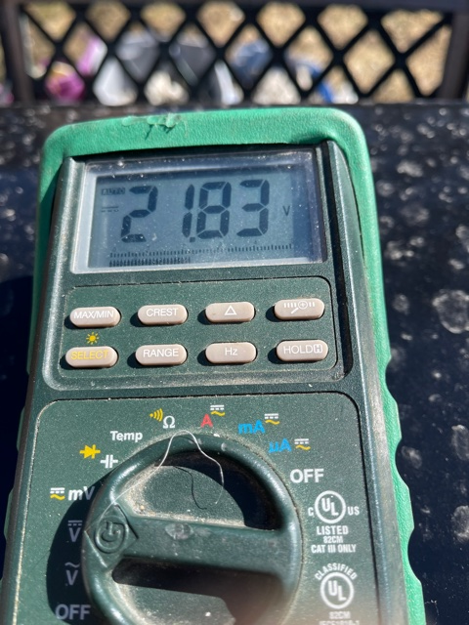
This is a reading from a 100 watt panel which has a nominal voltage of 12 volts and the open circuit voltage is a reading 21.83.., this panel is not connected at this time to any batteries.. So I will play with the angles for demonstration.

Slide 24
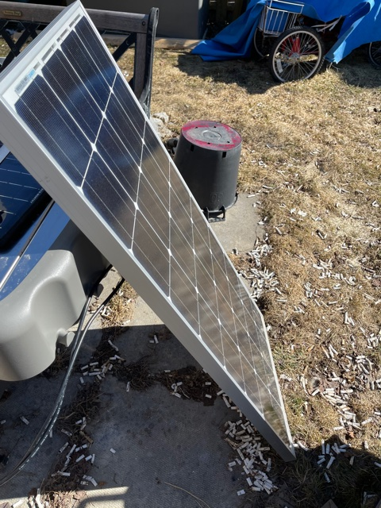
At this angle we currently have no shade and the angle is not ideal

Slide 25
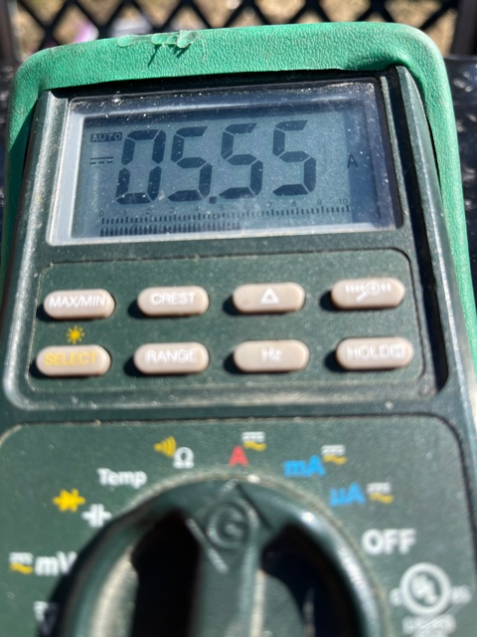
The reading I am getting here is 4.865 amp where in ideal condtions I should get 100/12= 8 amp roughly. But again the angle plays a big roll.

Slide 26
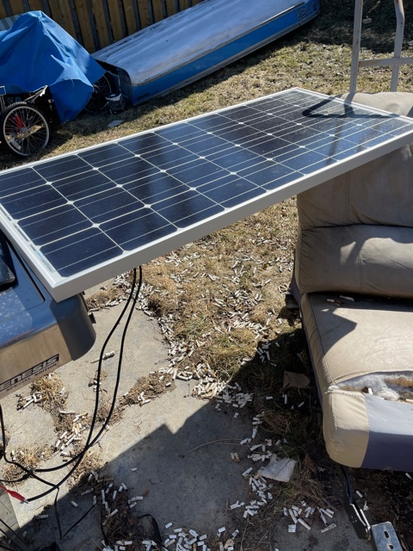
Here the angle is placed at about 90 degree, what do you think the current would be???

Slide 27
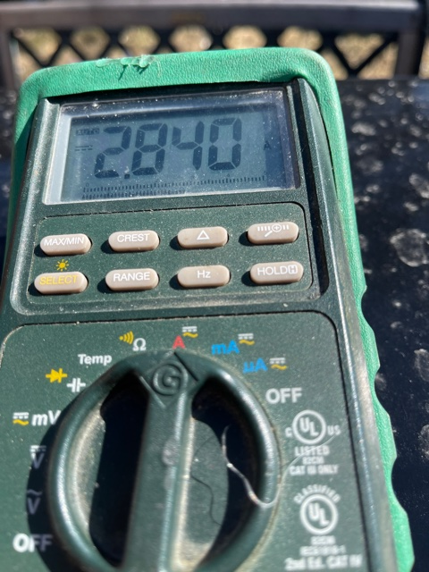
The current went from 4.8 amp to 2.8, it would still charge batteries but not as well as the 45 angle.

Slide 28
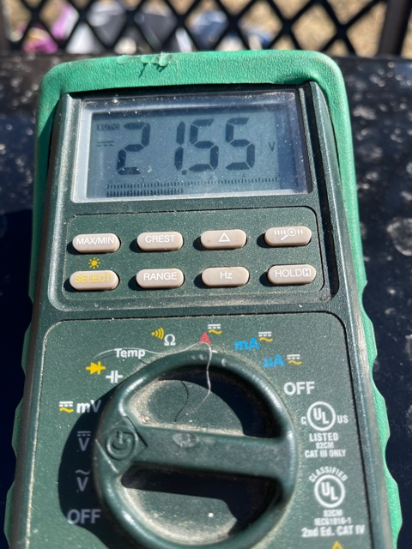
The voltage dropped only by a bit but the current dropped a lot.

Slide 29
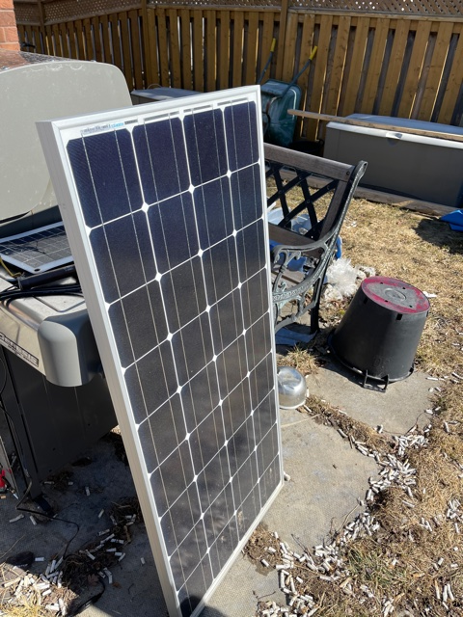
Here the panel is as vertical as I could get it without falling over., what is the suggested current???

Slide 30
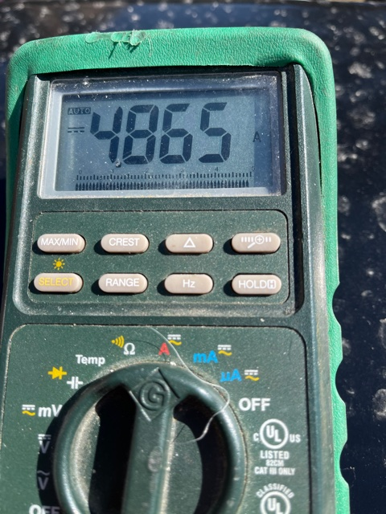
With the panel sitting vertical, the current is not as it should be at the proper angle.

Slide 31
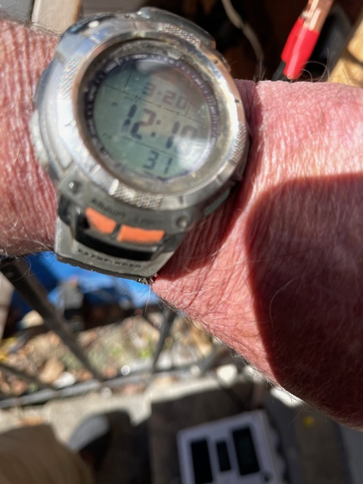

Slide 32
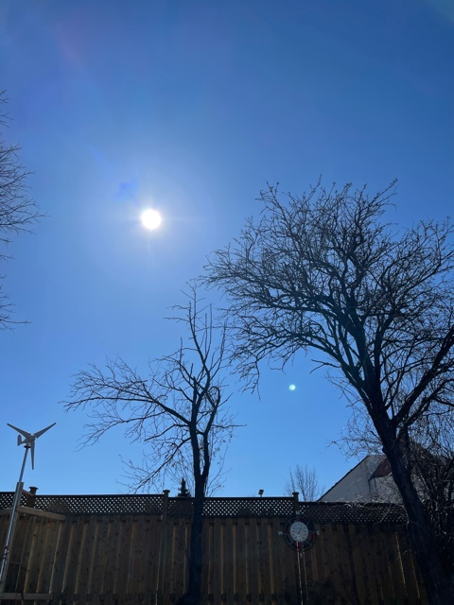
Its now solar noon, the sun should be at its strongest and then starts to move away to in an arch toward the west and sunset.

Slide 33
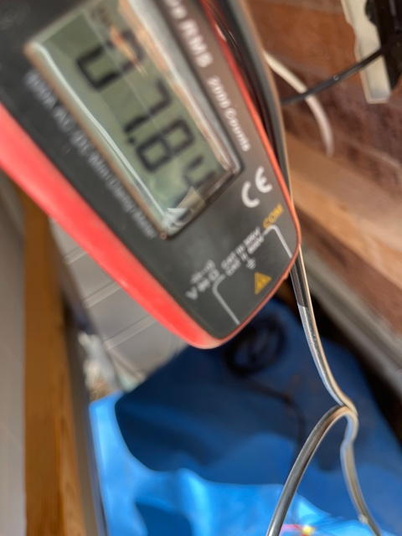
This is the best I can get today on the 230 watt panel which is 7.84 amp.. In ideal conditions it should be 9.58 amp giving the proper angle of the panel with relation to the sun and the distance of the sun and the location we are at.. Which will change in the summer solstice where the sun will be more direct.
In this situation using 24 volt panels, we could charge 12 volt batteries by using an mppt controller and essentially doubling the current to 15 amp which could charge 8 batteries in parallel

Slide 34
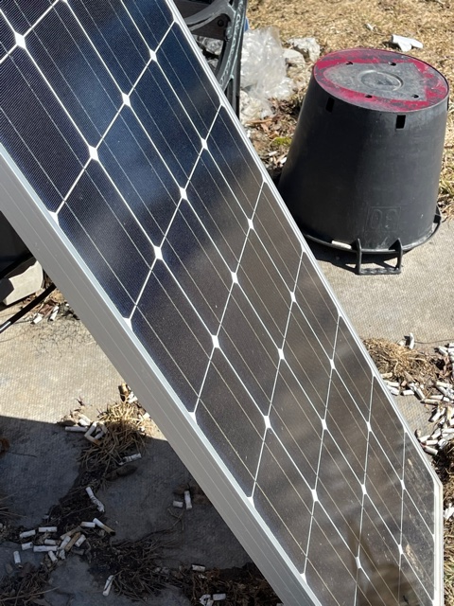
Let see what the 100 watt panel reads at about a 40 degree angle

Slide 35
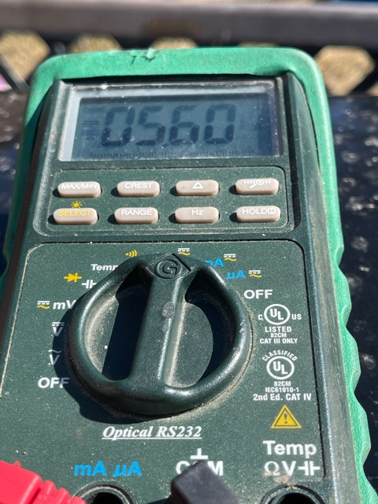
At this time.. We are getting 5.6 amp where in ideal conditions we should get somewhere around 8.3 amp.
To have a good charge onto a battery, we should charge it at around 2 amp per battery. If we get 1 amp per battery, it would be a slight charge but categorized as a maintaining current. So this situation could charge 3- 12 volt batteries in parallel

Slide 36
Thanks for watching.

