Slide 1
Energy from the Sun Workshop
Introduction to Photovoltaics

Slide 2
Electricity Basics
Electrical Current – how many electrons
Voltage – how hard they’re pushed
Power – what they can accomplish
Circuit – where they can go
Series Circuit – one pathway only
Parallel Circuit – so many choices!
Notes:
Electricity is simply the movement of electrons in one general direction, often through a conductor. A conductor is a substance that easily allows the flow of electrons through it, and the electron clouds of the atoms or molecules will often overlap. Each electron has a certain amount of electrical charge attributed to it, and electrical current measures the number of electrical charges passing a fixed point in one second. The units for current are Amperes, and it’s represented by the variable I.
Voltage is to electricity as water pressure is to water flow. The higher the voltage, the harder the “push,” or the greater potential for electrons to move. In fact, voltage is defined as electrical potential. The unit for measuring voltage is the Volt and it’s represented by V.
Power is mathematically calculated by multiplying the current in Amps by the voltage in Volts. Or, P=VxI. Power is literally how much can get done in a certain amount of time. In this case, it is a combination of voltage and current that is necessary to accomplish a certain task, such as running a dishwasher or lighting a room.
A circuit is a closed-loop pathway through which electrons can flow. A circuit involves a power source, such as a battery or solar cell, and a load, such as a light bulb or electrical motor. An open circuit is one that is not fully connected, such as when the switch is turned “off.” A closed circuit is one that is closed and electrons are moving. Often, circuits that are left closed, with electricity flowing, for long periods of time get hot. This is because as the energy is passed from electron to electron, some of that energy is lost in the transfer to thermal energy. Thus, the wires or components in the circuit get hot.
A series circuit is one in which multiple objects are connected one after another, and there is only one way for electrons to flow. A parallel circuit in one in which there are multiple loops for electrons to flow. The next slide shows schematic diagrams for circuits.

Slide 3
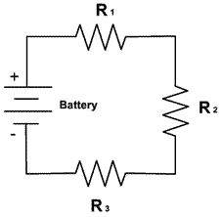
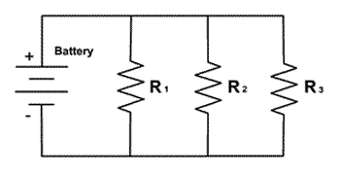
Parallel vs. Series Circuits
Parallel circuits
maintain potential (voltage is constant)
Current is divided among components
If one light goes out, the others stay lit
Series circuits
maintain electrical flow (current is constant)
Voltage is divided among components
Easy to open circuit quickly
Notes:
Homes, Christmas lights, and many other things are wired in parallel, because one component not working will not shut off the whole circuit. Old Christmas lights, which went dark when just one bulb burned out, were wired in series. Both ways of wiring circuits have advantages and disadvantages, depending on the application and components involved.
Squiggly lines in the diagrams indicate resistors. Because all electrical objects have a certain amount of resistance to electrical current flow, any device can be represented by a resistor. The most commonly used educational load is a little light bulb or a buzzer of some sort.

Slide 4
DC vs. AC
Direct Current
“Battery power”
Electronics use
Requires prohibitively high voltage to transmit over long distance
Alternating Current
EASY to generate
Can be transformed in voltage
Can be limited while keeping voltage high
Can be transmitted over long distance without super-high voltage
Notes:
The earliest, purposeful generation of electricity used electrochemical cells, or wet cells, which were the precursors to today’s batteries. Batteries produce DC, or direct current, power. The current in DC power runs in one direction only. Most electronics, such as stereos, speakers, and computers, operate on DC. With DC the electrical current occurs in one direction only through the circuit.
Alternating current was developed by Nicola Tesla and was adopted by Westinghouse and others as a means of distributing electricity without using super-high voltage. The electrical current in an AC circuit changes direction; standard US wiring works on 60 changes in direction per second, or 60 Hertz. AC current can be “stepped” up or down in its voltage using transformers, and this allows it to be transmitted over great distances. To use AC current to power things like computers and cell phone chargers, a AC/DC converter is connected, either within the power cord itself or in the device.

Slide 5
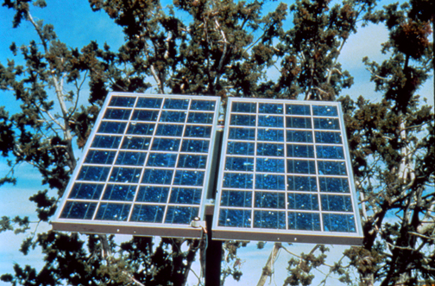
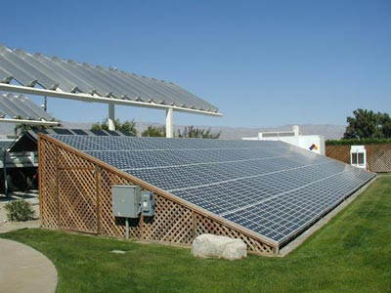
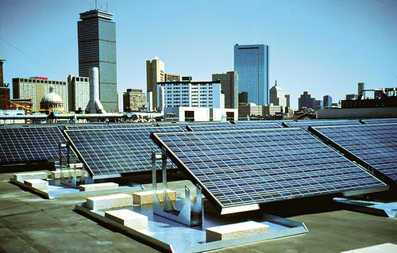
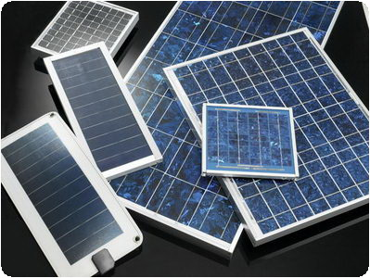
Photovoltaics
Notes:
Photovoltaic systems convert sunlight directly into electricity, and are potentially one of the most useful of the renewable energy technologies.
Also known as solar cells, PV systems are already an important part of our lives. The simplest systems power many of the small calculators and wrist watches we use everyday.

Slide 6
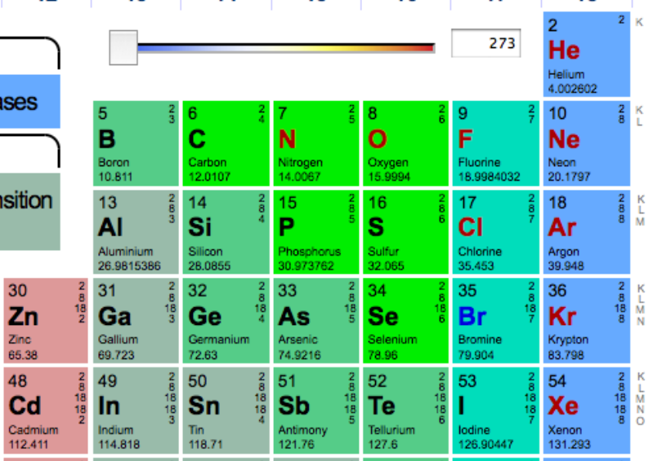
Notes:
Elements are arranged in the periodic table such that groups – columns – of elements have the same numbers of valence (outer) electrons. The valence electrons dictate the chemical behavior of the element.
Silicon is the most common semiconductor, but germanium is also used. A semiconductor will only conduct electricity under certain conditions, so it’s more easily controlled than something like copper or silver. Silicon has four valence electrons.
Boron, like all elements in its group, has only three valence electrons, which means it can easily accept electrons. Phosphorous, like all elements in its group, has five valence electrons, and can easily lose an electron. These two elements make suitable doping materials in photovoltaic cells because of their ability to give up or accept electrons. Doping materials are substances added in small quantities to a semiconductor to create an imbalance, of sorts, in electron distribution.

Slide 7
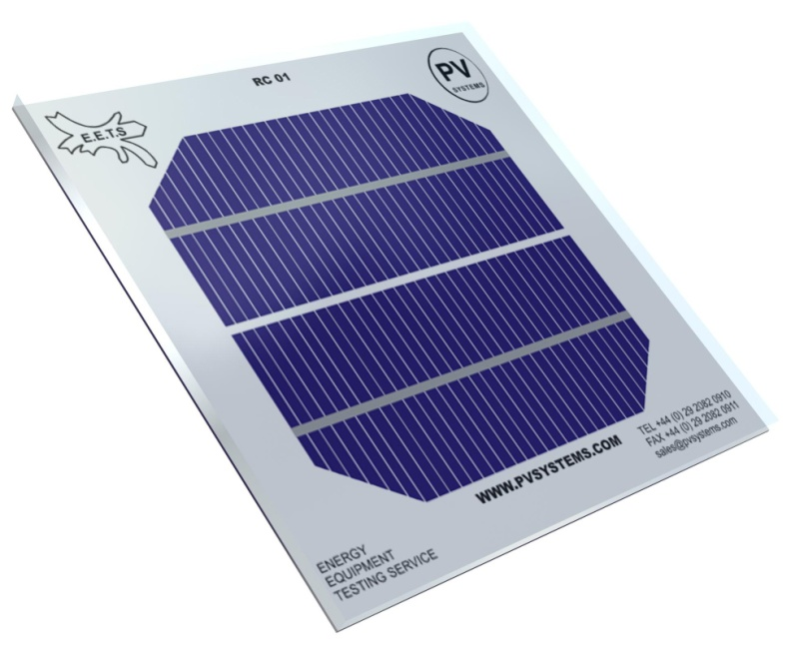
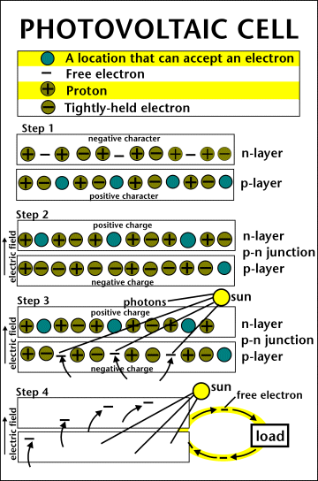
PV Cell
Notes:
The photovoltaic cell is the basic building block of a PV system. Individual cells can vary in sizes from about 1cm to about 10 cm across. Most cells are made with silicon today. Silicon must be purified– this is one of the biggest expenses in the production of solar cells.
A slab (or wafer) of pure silicon is used to make a PV cell. The top of the slab is very thinly diffused with an “n” dopant, such as phosphorous. On the base of the slab, a small amount of a “p” dopant, typically boron, is diffused. The boron side of the slab is 1,000 times thicker than the phosphorous side. Dopants are similar in atomic structure to the primary material. The phosphorous has one more electron in its outer shell than silicon, and the boron has one less. These dopants help create the electric field that motivates the energetic electrons out of the cell created when light strikes the PV cell.
The phosphorous gives the wafer of silicon an excess of free electrons; it has a negative character. This is called the n-type silicon (n = negative). The n-type silicon is not charged—it has an equal number of protons and electrons—but some of the electrons are not held tightly to the atoms. They are free to move to different locations within the layer.
The boron gives the wafer of the silicon a positive character, which will cause electrons to flow toward it. The base of the silicon is called p-type silicon (p = positive). The p-type silicon has an equal number of protons and electrons; it has a positive character, but not a positive charge.
Where the n-type silicon and p-type silicon meet, free electrons from the n-type flow into the p-type for a split second, then form a barrier to prevent more electrons from moving between the two sides. This point of contact and barrier is called the p-n junction.
When both sides of the silicon slab are doped, there is a negative charge in the p-type section of the junction and a positive charge in the n-type section of the junction due to movement of the electrons and “holes” at the junction of the two types of materials. This imbalance in electrical charge at the p-n junction produces an electric field between the p-type and n-type.
If the PV cell is placed in the sun, photons of light strike the electrons in the p-n junction and energize them, knocking them free of their atoms. These electrons are attracted to the positive charge in the n-type silicon and repelled by the negative charge in the p-type silicon. Most photon-electron collisions actually occur in the silicon base.

Slide 8
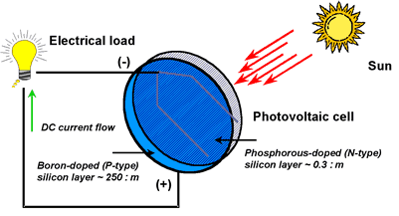
Notes:
A conducting wire connects the p-type silicon to an external load such as a light or battery, and then back to the n-type silicon, forming a complete circuit. As the free electrons are pushed into the n-type silicon they repel each other because they are of like charge. The wire provides a path for the electrons to move away from each other. This flow of electrons is an electric current that can power a load, such as a calculator or other device, as it travels through the circuit from the n-type to the p-type.
In addition to the semi-conducting materials, solar cells consist of a top metallic grid or other electrical contact to collect electrons from the semi-conductor and transfer them to the external load, and a back contact layer to complete the electrical circuit.
It is this flow of electrons that produces electrical current.

Slide 9
Conversion Efficiency
Notes:
The conversion efficiency of a PV cell is the proportion of sunlight energy that the cell converts into electrical energy.
This is very important because improving this efficiency is vital to making PV energy competitive with more traditional sources of energy, such as fossil fuels.
The first PV cells were converting light to electricity at 1 to 2 percent efficiency.
Today’s PV devices convert up to 17 percent of the radiant energy that strikes them into electric energy. (40% NREL)

Slide 10
PV Array Components
PV Cells
Modules
Arrays
Notes:
One PV cell only produces 1 or 2 watts of electricity, which isn't enough power for most applications.
To increase power, groups of solar cells are electrically connected and packaged into weather-tight modules and arrays to provide useful output voltages and currents for a specific power output.
A PV System typically consists of 3 basic components.
PV cells - Electricity is generated by PV cells, the smallest unit of a PV system
Modules - PV cells are wired together to form modules which are usually a sealed, or encapsulated, unit of convenient size for handling.
Arrays – Groups of panels make up an array.

Slide 11
PV System Components
Notes:
Solar PV System
Solar cells produce direct current (DC), therefore they are only directly used for DC equipment. If alternating current (AC) is needed for AC equipment or backup energy is needed, solar photovoltaic systems require other components in addition to solar modules. These components are specially designed to integrate into solar PV systems. The components of a solar photovoltaic system are:
Solar Module -- the essential component of any solar PV system that converts sunlight directly into DC electricity.
2. Solar Charge Controller -- regulates voltage and current from solar arrays, charges the battery, prevents battery from overcharging and also performs controlled over discharges.
3.Battery -- stores current electricity produced from solar arrays for use when sunlight is not available.
4. Inverter -- a critical component of any solar PV system that converts DC power into AC power.
5. Lightning protection -- prevents electrical equipment from damage caused by lightning or induction of high voltage surge. It is required for the large size and critical solar PV systems, which include grounding.

Slide 12
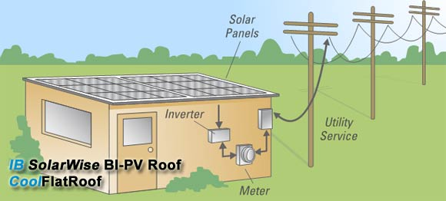
Net Metering
Notes:
A PV system produces DC-current.
The DC current goes into an Inverter where it becomes AC current.
An inverter is connected to your home’s or building’s electric system, and to your meter.
You use all electricity needed, while all excess electricity goes into the grid.
Electricity that goes into the grid is purchased from you by your utility company through Net Metering, usually at retail price.
While this option is not offered by many utility companies, the number is growing. In 2002, there 4,472 customers who participated in net metering programs. In 2007, there were 48,820 customers using the net metering program.

Slide 13
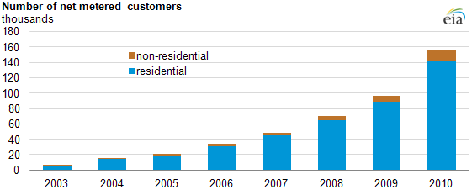
Net Metering Participation
Notes:
Source: U.S. Energy Information Administration, Electric Power Annual. Note: The chart counts the number of net-metering customers and does not indicate the generator size or amount of generation. Non-residential includes the commercial and industrial sectors; net-metered generators in these sectors are typically larger than residential generators.

Slide 14
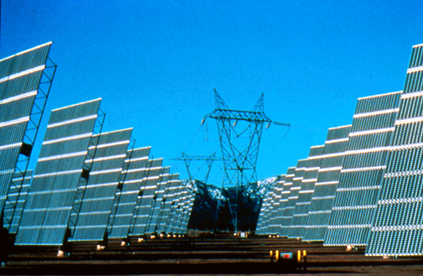
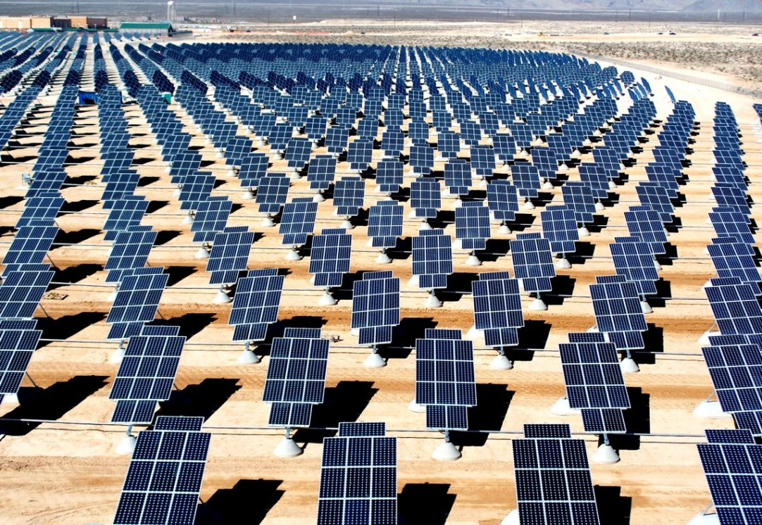
PV Array Fields
Notes:
In order to generate large amounts of electricity which can be fed into the electric grid, large number of arrays can be wired together to form an Array Field.
Some utility companies in the U.S. are turning to large PV systems to help meet peak power demand and reduce the need for building new power plants.

Slide 15
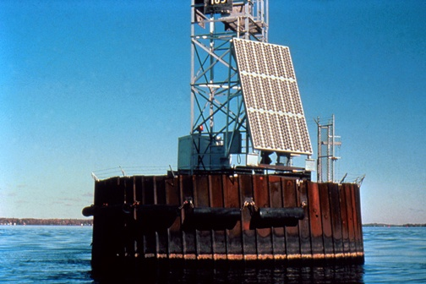
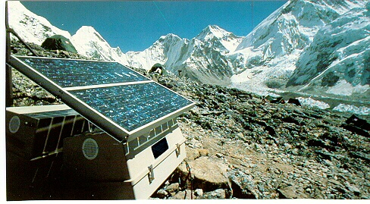
Notes:
Photovoltaic systems are ideal for remote applications where other power sources are impractical or unavailable, such as in the Swiss Alps or on navigational buoys. It is not practical to connect these applications to an electric grid. They are also used to power small, independently placed objects, such as billboards and road signs.

Slide 16
Source: Solarbuzz, a part of The NPD Group

Slide 17
Advantages of Solar Energy
Clean
Sustainable
Free
Provide electricity to remote places
Notes:
Solar energy produces no air pollution, thermal pollution, or water pollution, nor does acquiring solar energy disrupt a natural environment. The sun simply shines whether we use the energy or not. Solar energy is a completely sustainable energy source. Yes, one day the sun will stop producing energy, but if that happens we will have more problems to worry about than how we’ll charge our cell phones! Solar energy is one of the last free resources available to us, and it is available to us in such vast quantities we could never use all of it at any given time. Because the sun shines everywhere, and not just where people are, it can be used in places where electricity may not be otherwise available or practical.

Slide 18
Disadvantages of Solar Energy
Less efficient and costly equipment
Part Time
Reliability Depends On Location
Environmental Impact of PV Cell Production
Notes:
Most photovoltaics are only 17-20% efficient. There are some experimental and developmental technologies being used in laboratories and by the space industry that are more efficient, but even those maximize at 43%. However, no energy is output in delivering the energy source to the PV panel; it is already right there to use, and does not require any initial energy or materials to get it to the site of use.
Because the sun is not shining constantly all the time in any given location, it cannot be counted on for continuous energy. The amount of solar energy available to an entity depends completely on the latitude, climate, time of day, and amount of air pollution present. Clouds or particulate matter in the air will lessen the amount of solar energy available to use in a PV cell. Higher latitudes do not receive as intense of sunlight as more tropical areas, and therefore will not be able to produce as much power through photovoltaics. All of these limit the degree to which photovoltaics can be used.
Another negative aspect to using photovoltaics is in the production of the materials in a PV cell. The entire production process does have a negative environmental impact, primarily from the energy required to produce the PV cell. There is a very small amount of heavy metals, such as lead and cobalt, produced in the purification of the materials being used, but that is far outshadowed by the amount of carbon dioxide and other air pollutants produced when the electricity necessary for production is generated. Replacing conventional, fossil fuel based electrical power generation will significantly reduce this impact. Furthermore, because the site of heavy metal toxicity is kept isolated at just production facilities, it can be more closely monitored and regulated than if the materials were more wide-spread.

Slide 19
Classroom Photovoltaics
Experiments help students understand the conditions needed for optimal power production
Focus of secondary-level solar curriculum
Use digital multimeters

Slide 20
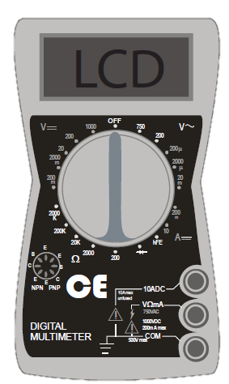
Using a Digital Multimeter
Indicates voltage from alternating current. Do not use.
DC Voltage Scale
DC Current Scale
Resistance Scale. Do not use.
Notes:
DC Voltage
Connect RED lead to VΩmA socket and BLACK to COM.
Set SWITCH to highest setting on DC VOLTAGE scale (1000).
Connect leads to the device to be tested using the alligator clips provided.
Adjust SWITCH to lower settings until a satisfactory reading is obtained.
With the photovoltaic modules and array, the 20 setting usually provides the best reading.
DC Current
Connect RED lead to VΩmA connector and BLACK to COM.
Set SWITCH to 10 ADC setting.
Connect leads to the device to be tested using the alligator clips provided.
Note: The reading indicates DC AMPS; a reading of 0.25 amps equals 250 ma (milliamps).

Slide 21
For More Information
If you have questions, we have answers:
www.need.org – our website
info@need.org – questions about NEED
cturrel@need.org – questions about this workshop
1-800-875-5029 – NEED main office phone number

