Slide 1
Series parallel power
Ref: batteries and PV Panels

Slide 2
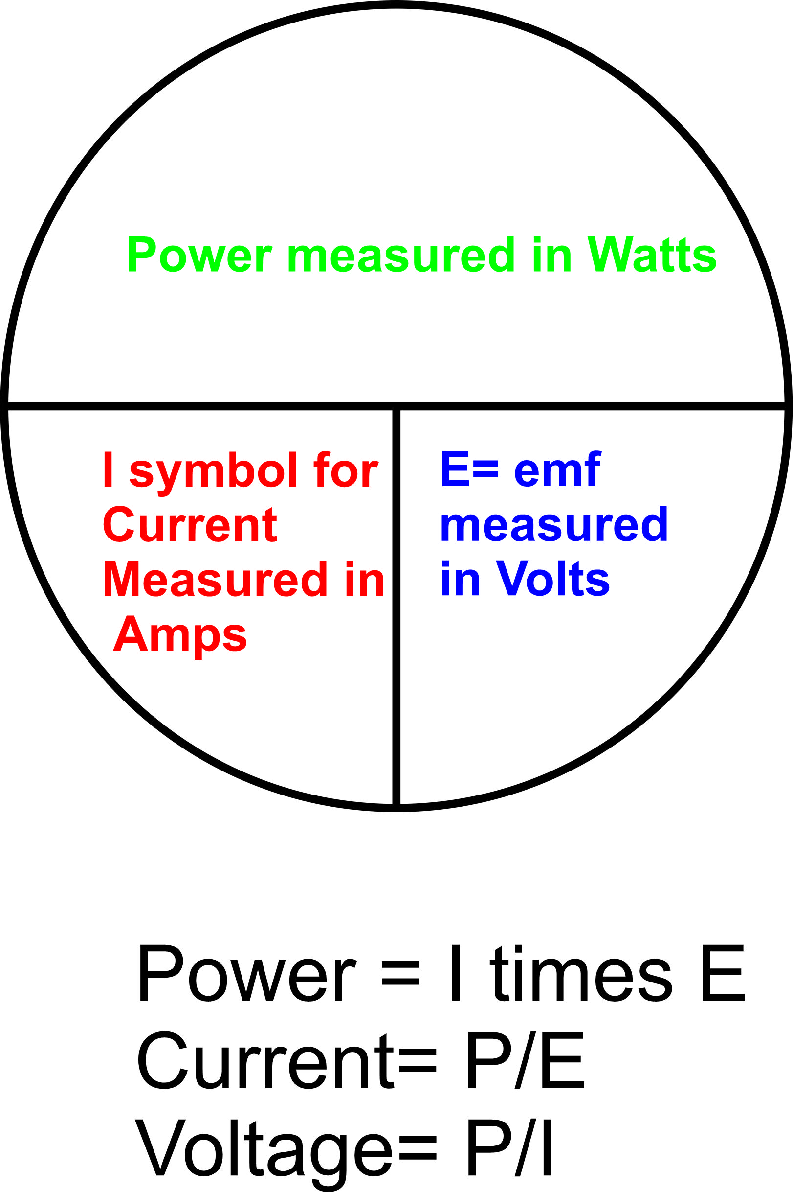
Watts law calculations

Slide 3
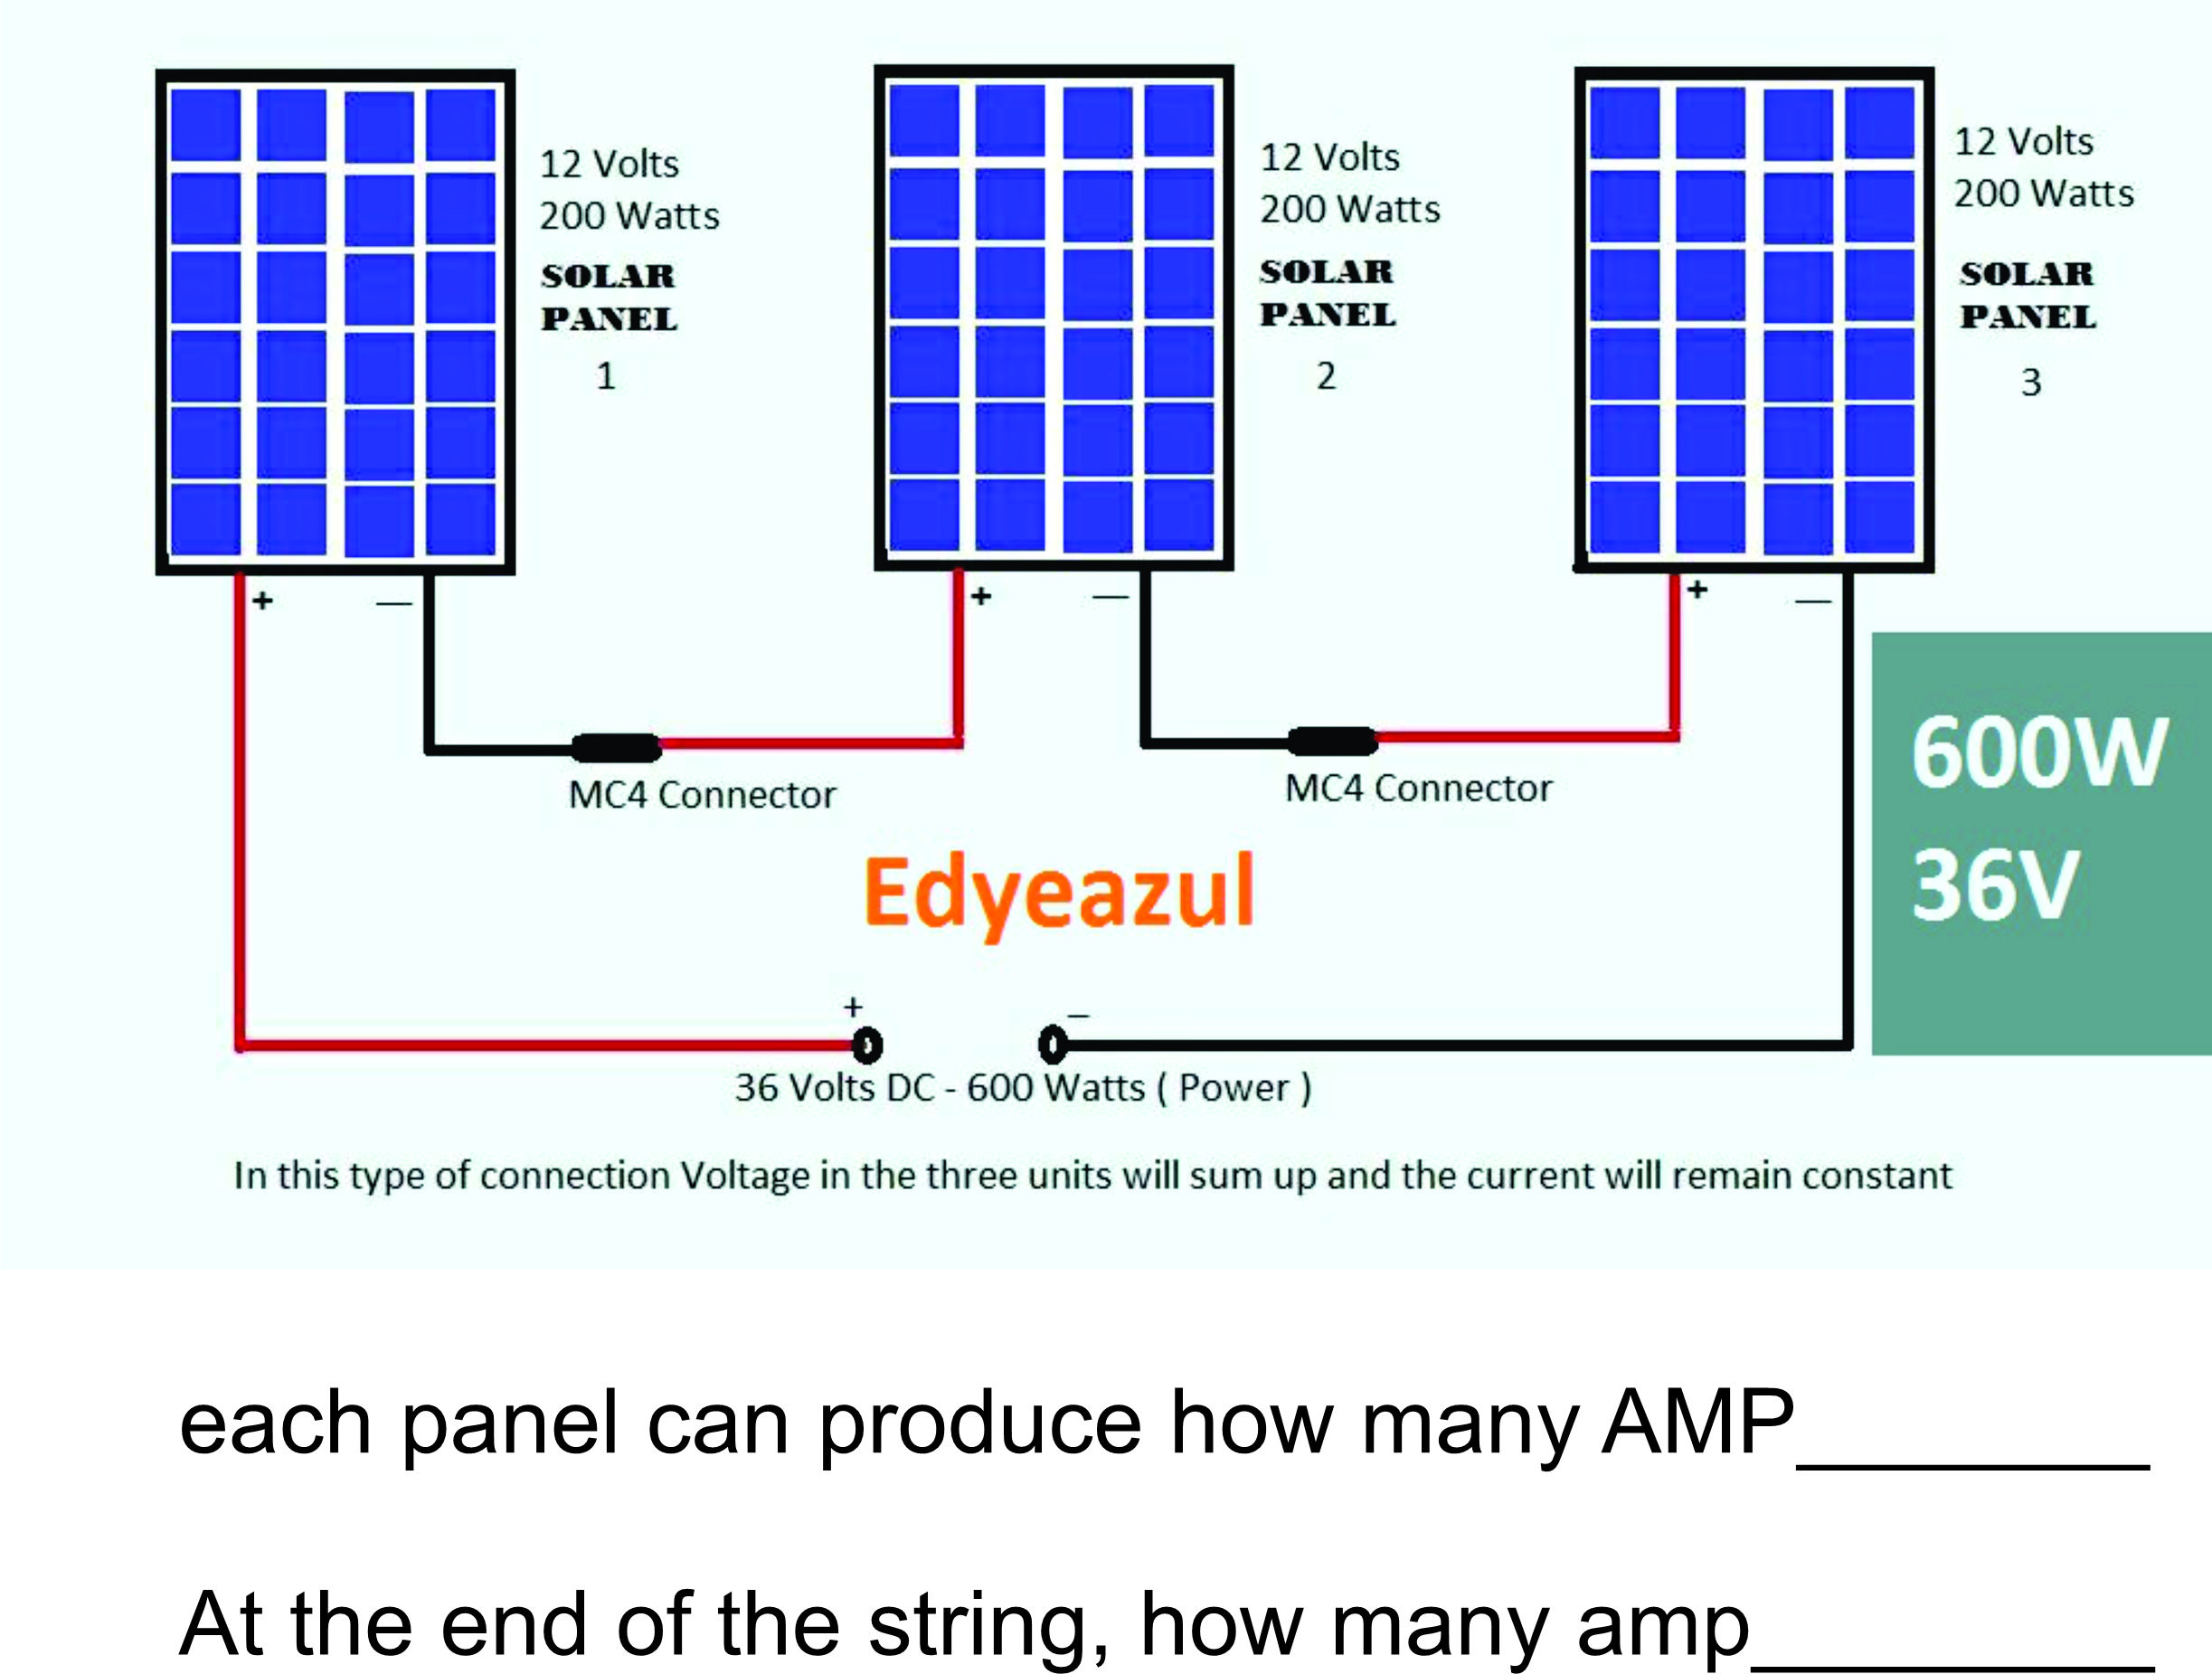

Slide 4
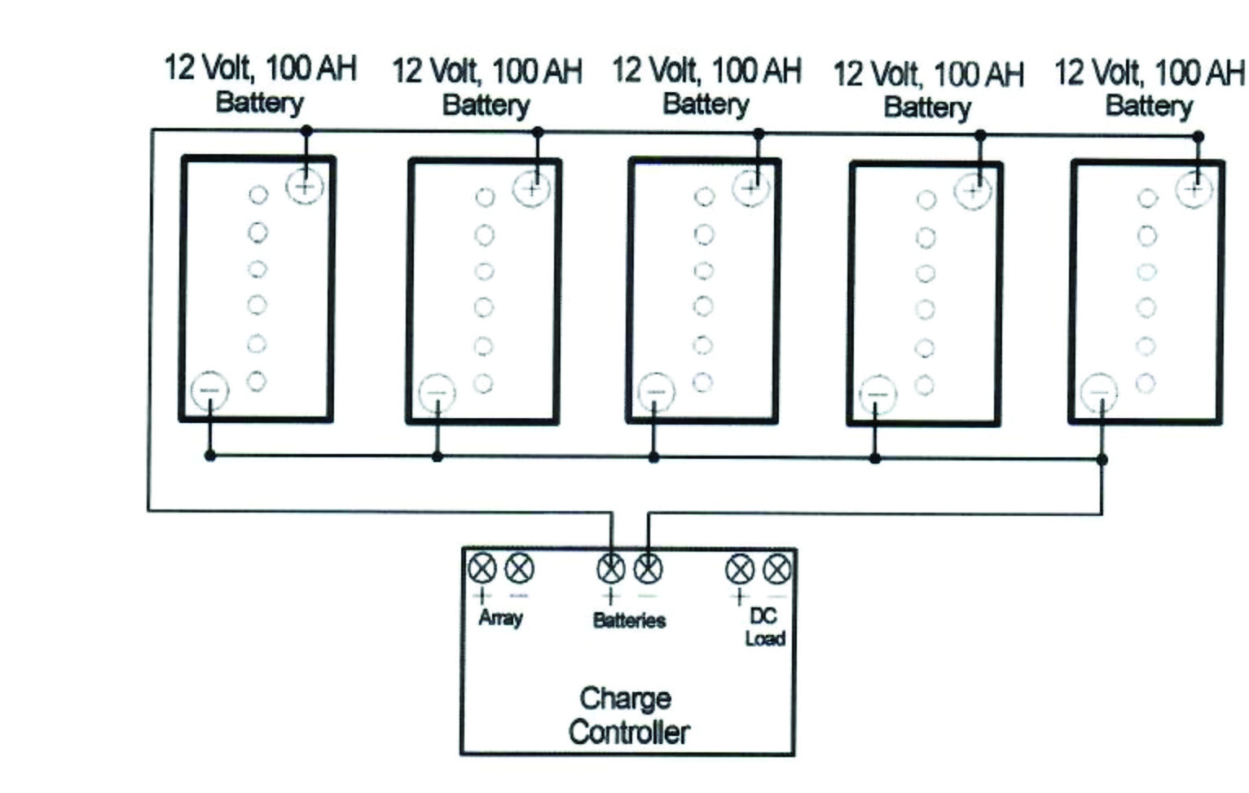
Batteries in Parallel,= 12 volt-500 A

Slide 5
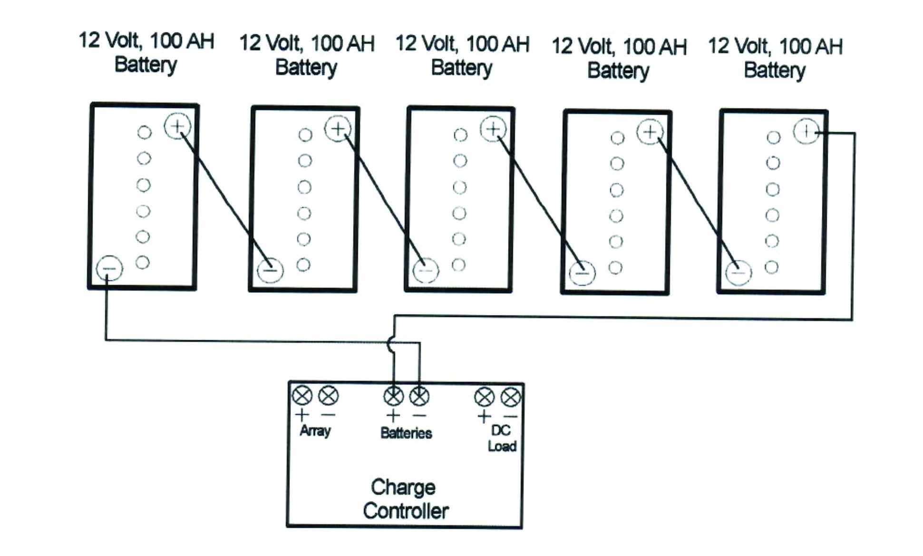
Batteries in Series, = 60 volt-100A

Slide 6
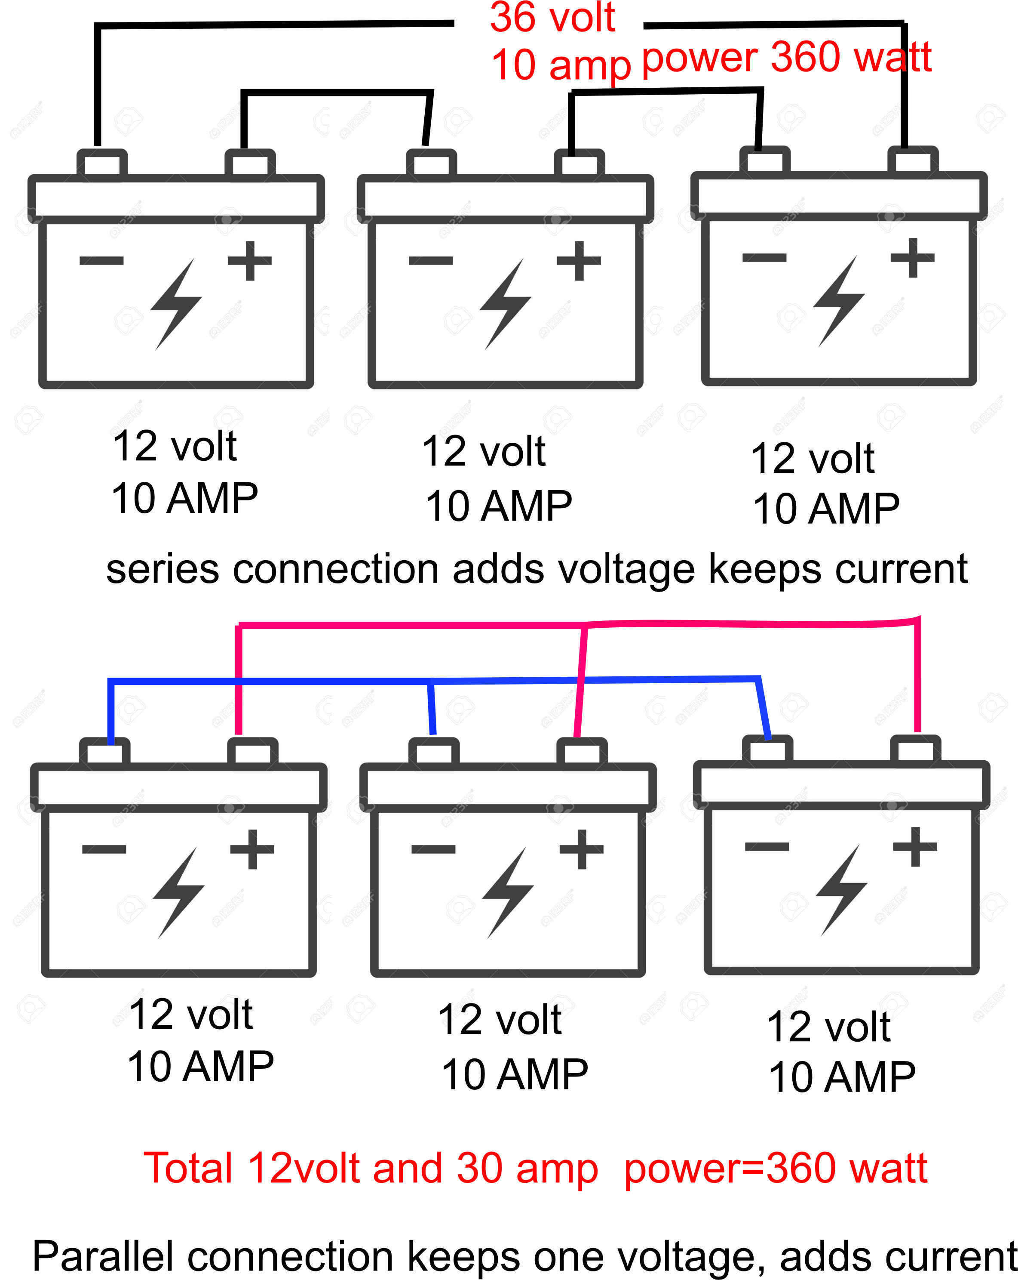
The difference but power stays the same

Slide 7
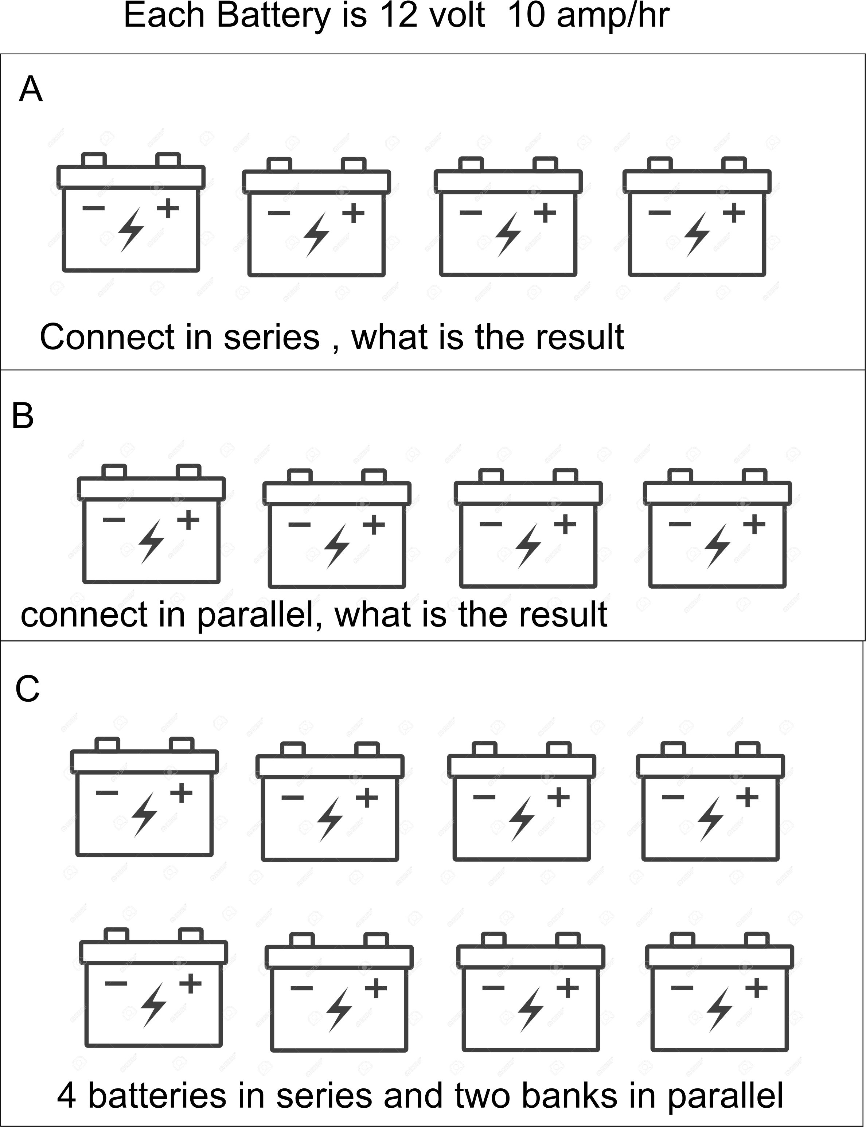
A=48 volt-10 amp
B= 12 volt 40 amp
C= 48 volt 80 amp

Slide 8
Batteries are rated in AH not Amp
The exercises were set up for simplicity of calculation…, Batteries are actually ratedin AMP Hrs.. Which is the amount of current it is capable to deliver over a period of time as they do deplete as they are being consumed.

Slide 9
PV Panels
PV panels are rated in Watts as voltages and currents change leaving an average power in watts… however both batteries and PV panels
Both work on the amount of current and voltage it can deliver… to average a 100 watt
PV panel, just use the formula I=P/E to calculate the rough amount of current it is capable to deliver.

