Slide 1
Introduction to Wind Turbines
M. McDonald

Slide 2
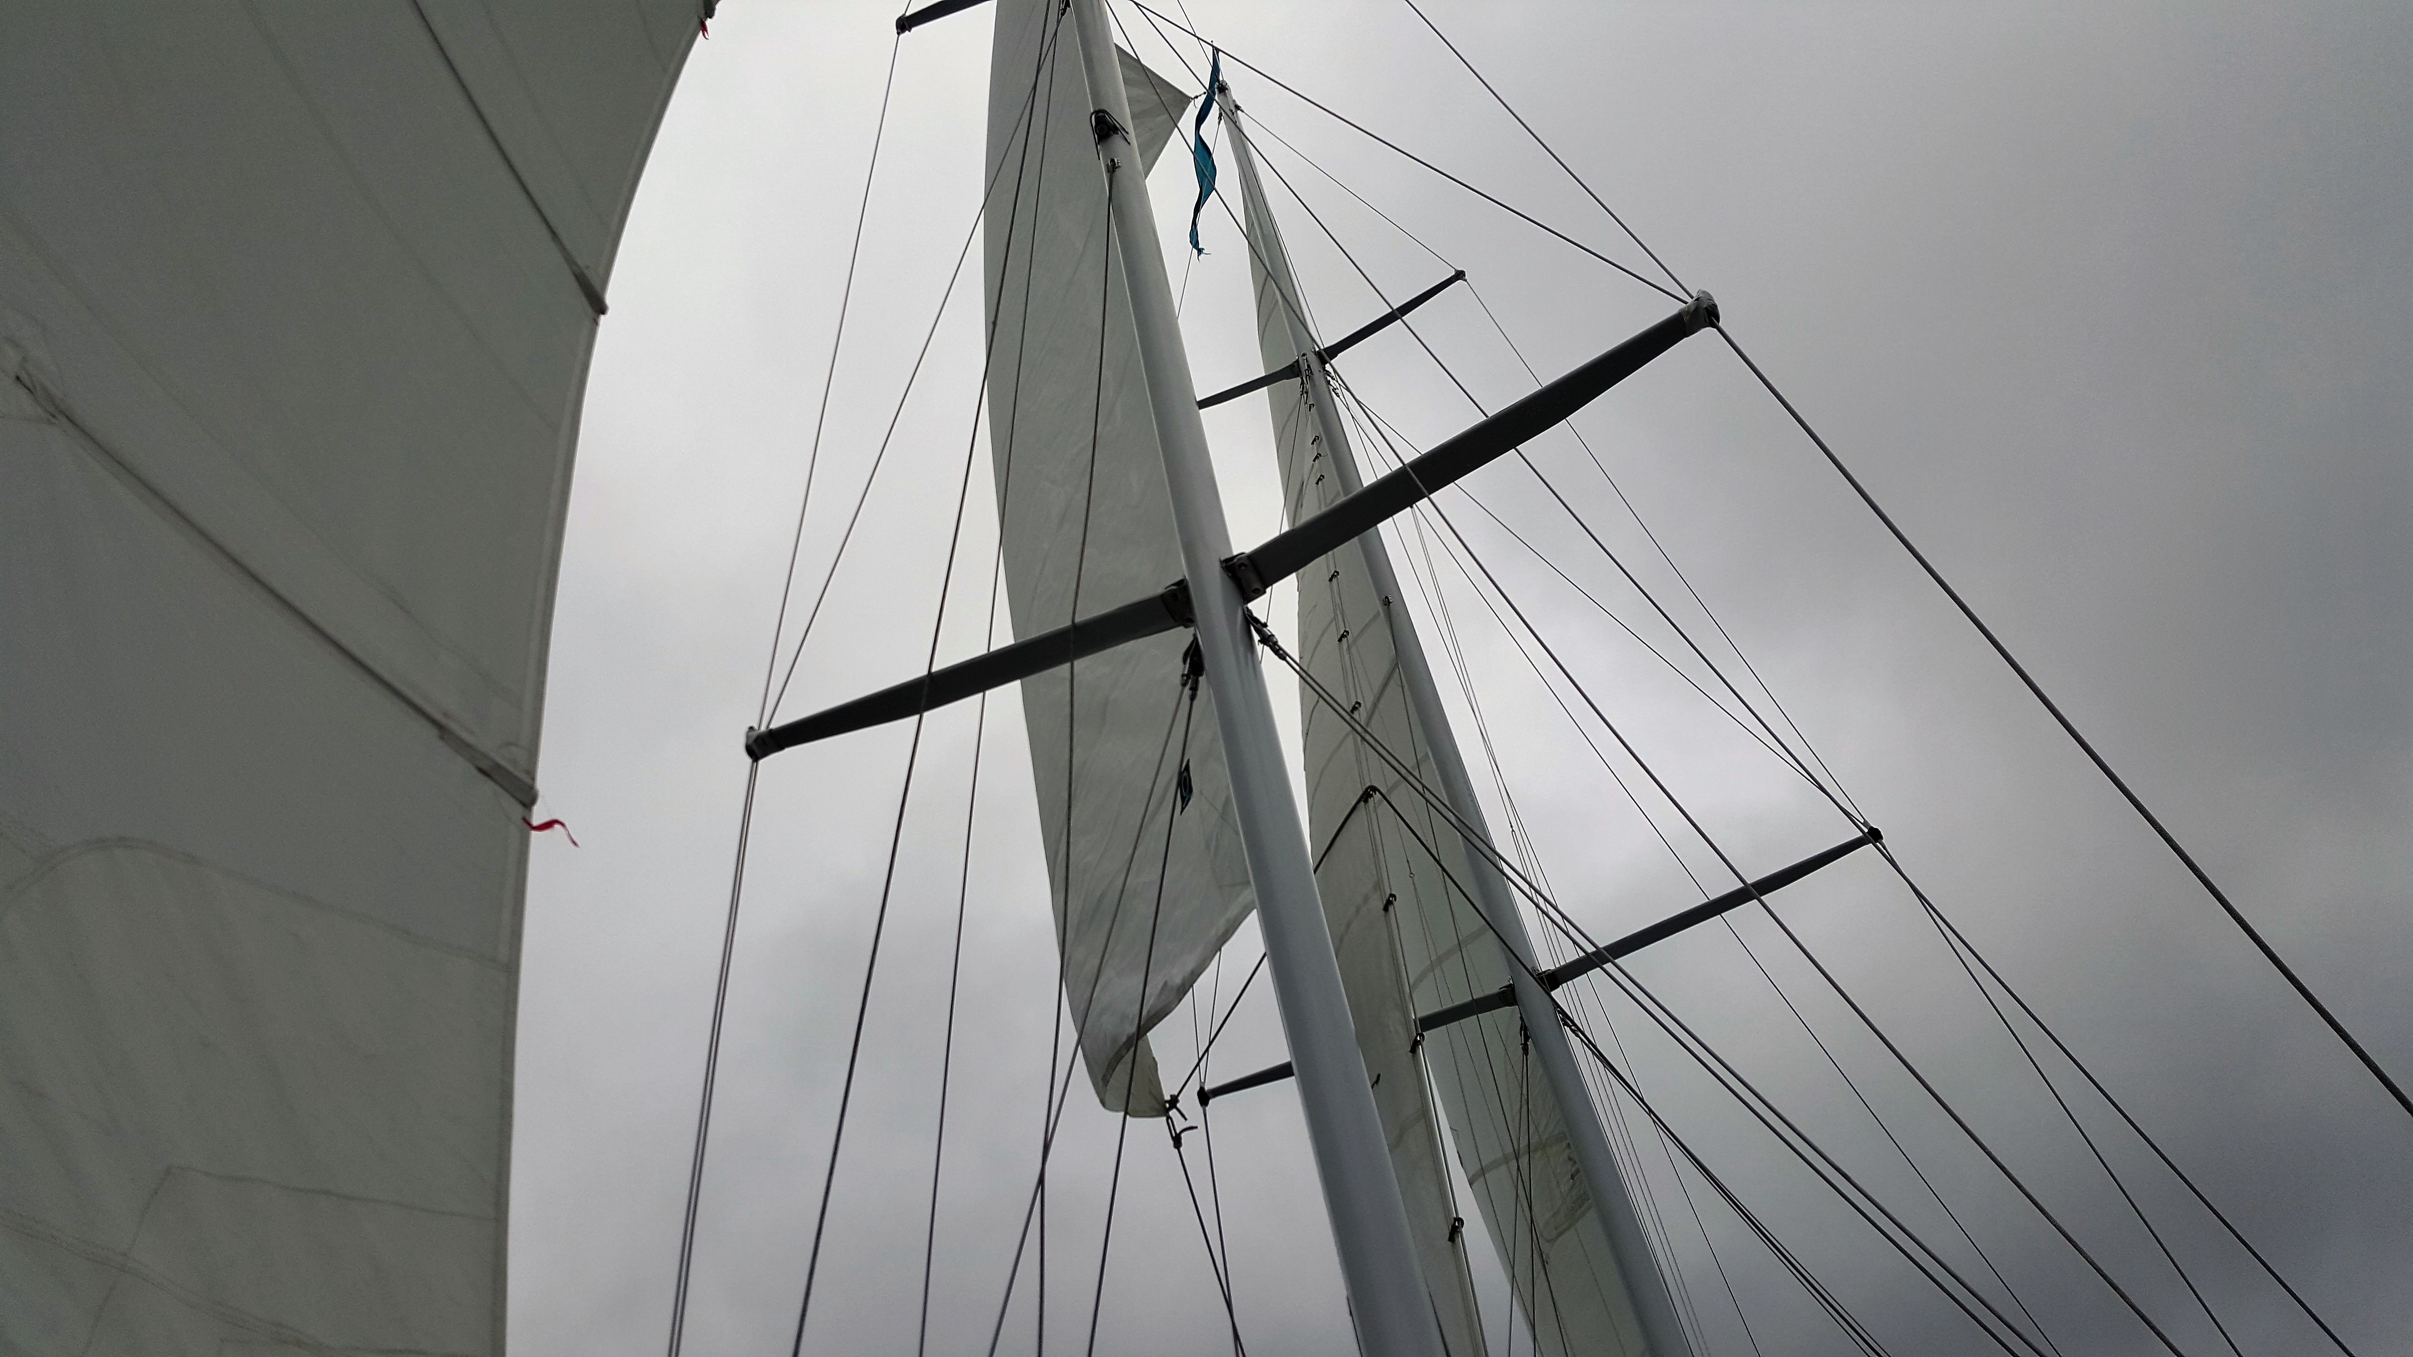
Wind Turbine Energy

Slide 3
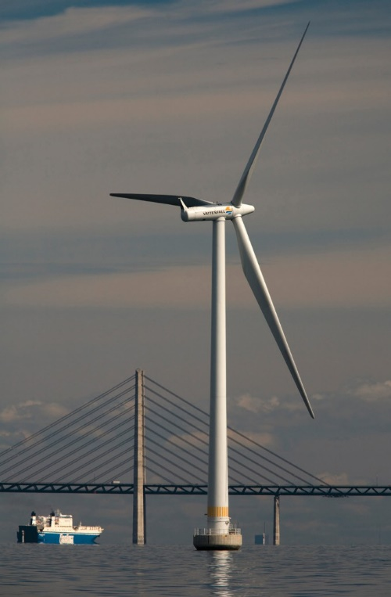
Wind Turbine
Wind energy is created when the atmosphere is heated unevenly by the Sun, some patches of air become warmer than others. These warm patches of air rise, other air rushes in to replace them – thus, wind blows.
A wind turbine transfers kinetic energy into a spinning shaft, which (usually) turns a generator to produce electricity. The power in the wind that’s available for harvest depends on both the wind speed and the area that’s swept by the turbine blades.

Slide 4
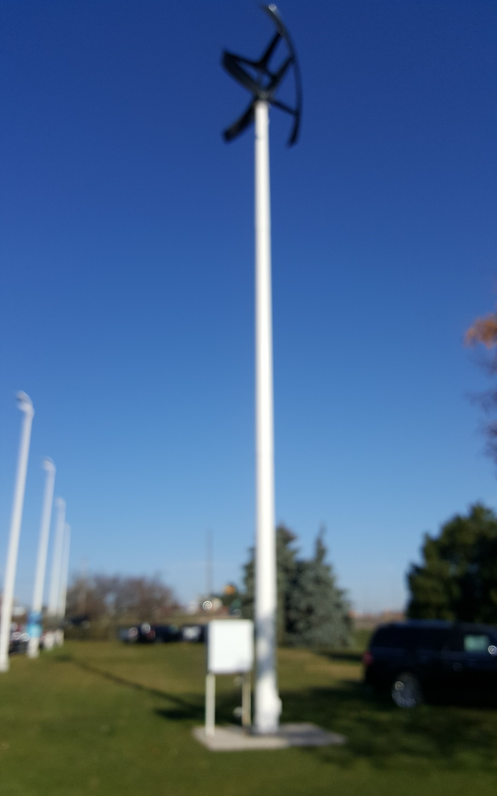
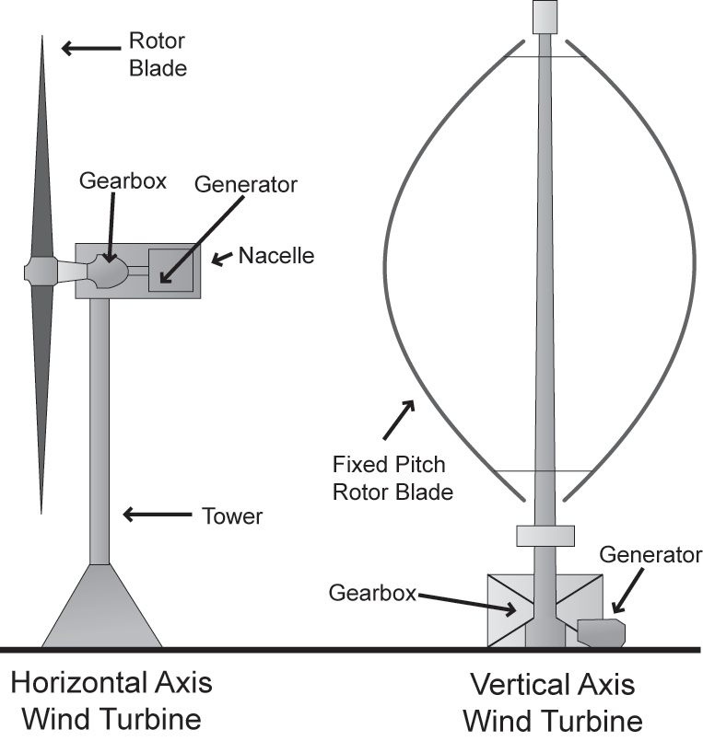
Wind Turbine Design
Vertical axis wind turbines (VAWTs) are not as common as HAWTs because they are less efficient at converting wind energy into mechanical work.
Do not need to face into the wind because the turbine blades can catch wind from many directions.

Slide 5
Wind Turbine Design
Horizontal axis wind turbines (HAWTs) are by far the most efficient and commonly used today. A HAWT receives wind power through their entire blade rotation. Its generator and gearbox are located at the top of the tower. The towers are often very tall (commonly between 30ft and 300ft above ground or sea level) and can access high wind speeds.

Slide 6
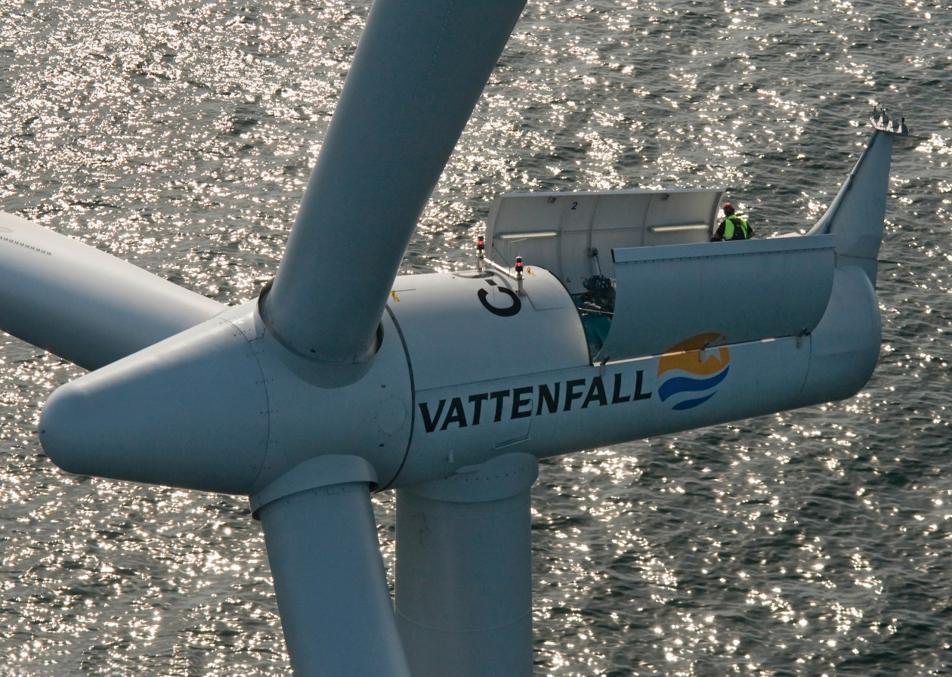
Main components of a Horizontal Axis Wind Turbine
Blades and rotor: Converts the wind power to a rotational mechanical power.
Generator: Converts the rotational mechanical power to electrical power.
Gear box: Wind turbines rotate typically between 40 rpm and 400 rpm. Generators typically rotates at 1,200 to 1,800 rpm. Most wind turbines require a step-up gear-box for efficient generator operation (electricity production).

Slide 7
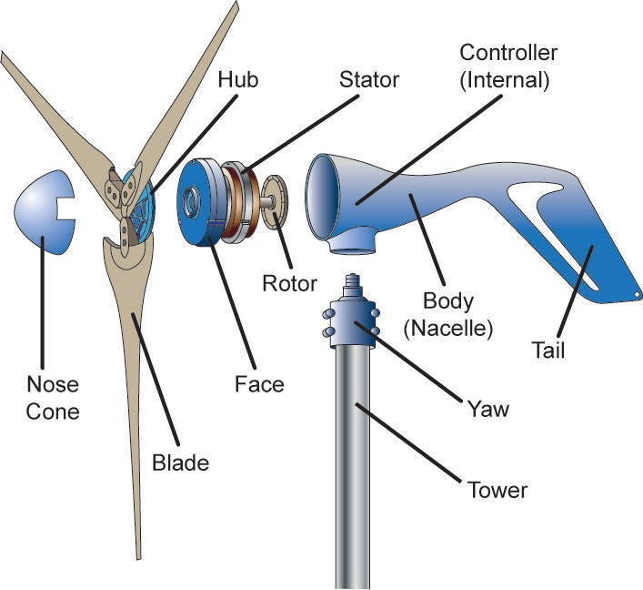
Main components of a Wind Turbine (small)
Nose cone—reduces wind resistance on front surface of hub.
Blades—the hub contains multiple blades to capture wind energy. Hub—front of rotor for securing propeller blades and nose cone. Face/bearings—supports shaft while allowing it to rotate.
Rotor—main shaft or axle with disk of permanent magnets (or electromagnets) that rotates. Turbine blades and hub are considered part of the rotor.
Stator—wire coil that remains stationary.
Nacelle—the body, housing, or fuselage of the assembly.
Tail—keeps the turbine facing into the wind.
Yaw/bearings—allows unit to swivel or rotate horizontally to face into the wind.
Controller—an electronic system to regulate braking, rotational speed, output power, blade pitch, etc.
Tower—supports the wind turbine above wind obstructions.

Slide 8
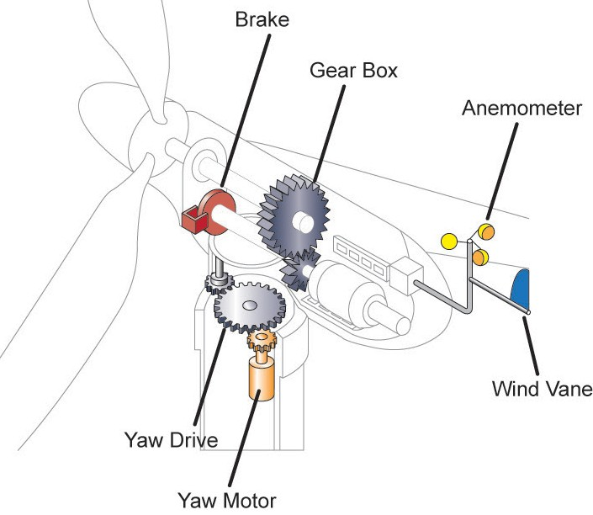
Main components of a Wind Turbine (large)
Brakes—mechanism to physically stop rotational movement of turbine.
Gearbox transmission—increases generator shaft speed for a given rotor speed. Anemometer—a device for measuring wind speed, and controlling the rotor speed.
Wind vane—a device for checking wind direction, and controlling the yaw drive.
Yaw motor and drivetrain— devices for controlling the swiveling or horizontal rotation of the turbine to ensure facing into the wind.

Slide 9
Braking
Stopping Mechanisms
On many large-scale wind-powered systems, mechanical braking is used to stop the rotation of the turbine shaft.
Rotary disc brakes are commonly used on the rotor shaft and tip brakes are sometimes incorporated into the blade design.
Just the tip of each blade can be rotated to slow a spinning turbine.
In some cases, the braking is enabled and disabled mechanically by a small winch at the base of the tower. Many systems use hydraulic oil pressure to keep the brakes
off; therefore, a hydraulic system failure results in braking the turbine rotor.
Braking may also be controlled by an electrical signal, in which case a switch can be used to control the braking mechanisms.

Slide 10
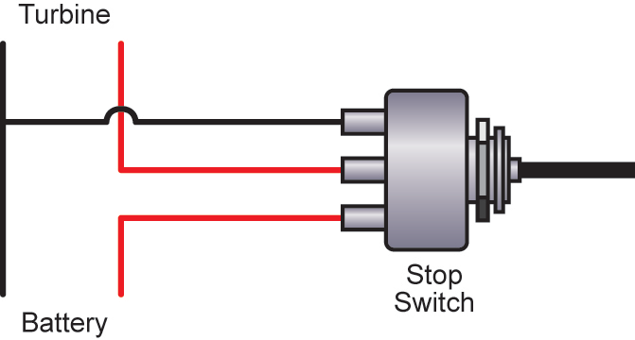
Braking on our LabVolt Equipment
The stator winding in the generator is electrically shorted
to enable dynamic braking.
The generator output is connected (through the internal charge controller) to the stator winding. When the output leads are shorted, the stator winding is shorted.
Under these circumstances, the battery bank must be disconnected from the generator output to prevent a potential explosion or fire hazard. With the stator windings shorted, high
current flows through the winding as the rotor is turned. This high current in the winding creates strong magnetic fields that “buck” with the magnetic fields of the rotor.
These repelling forces prevent the rotor from turning easily. The end result is that any attempt to rotate the rotor shaft becomes difficult and requires a large amount of force whenever the generator output is electrically shorted.
SPDT single pole double throw

Slide 12
Typical Wind Turbine Operation
0 ~ 10 mph --- Wind speed is too low for generating power. Turbine is not operational. Rotor is locked.
10 ~ 25 mph --- 10 mph is the minimum operational speed. It is called “Cut-in speed”. In 10 ~ 25 mph wind, generated power increases with the wind speed.
25 ~ 50 mph --- Typical wind turbines reach the rated power (maximum operating power) at wind speed of 25mph (called Rated wind speed). Further increase in wind speed will not result in substantially higher generated power by design. Dropping turbine speed is accomplished by, for example, pitching the blade angle to reduce the turbine efficiency.
> 50 mph --- Turbine is shut down when wind speed is higher than 50mph (called “Cut-out” speed) to prevent structure failure.

Slide 13
Wind Turbine
The Generator
The generator converts the mechanical energy of the turbine to electrical energy (electricity).
Inside this component, coils of wire are rotated in a magnetic field to produce electricity. Different generator designs produce either alternating current (AC) or direct current (DC), available in a large range of output power ratings.
Generators that produce AC are generally equipped with features to produce the correct voltage (120 or 240 V) and constant frequency (60 cycles) of electricity, even when the wind speed is fluctuating.

Slide 14
Wind Turbine
Transmission
Most wind turbines require a gear-box transmission to increase the rotation of the generator to the speeds necessary for efficient electricity production.
The number of revolutions per minute (rpm) of a wind turbine rotor can range between 40 rpm and 400 rpm, depending on the model and the wind speed. Generators typically require rpm's of 1,200 to 1,800.
Some DC-type wind turbines do not use transmissions. Instead, they have a direct link between the rotor and generator. These are known as direct drive systems. Without a transmission, wind turbine complexity and maintenance requirements are reduced, but a much larger generator is required to deliver the same power output as the AC-type wind turbines.

Slide 15
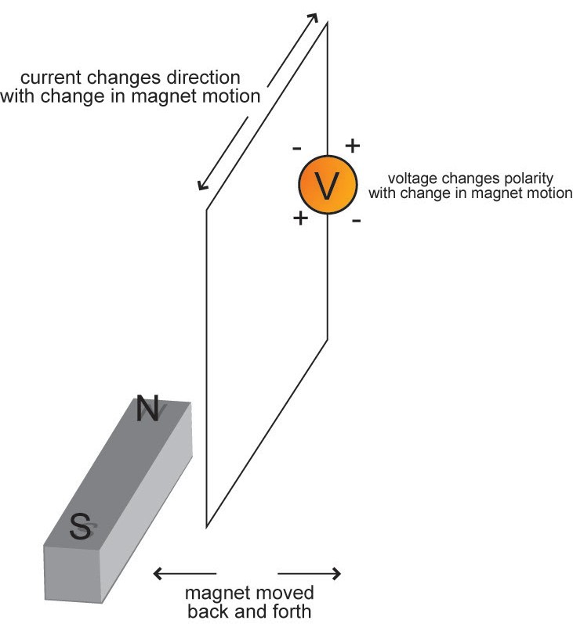
Alternators & Generators
Electromagnetic Induction
As a wire conductor cuts through a magnetic field, voltage is induced, and electrical current flows through the wire.
Some generators use permanent magnets, and some use electromagnetic coils to create the required magnetic fields. In both cases, a wire coil either passes through a magnetic field or vice-versa, depending upon which part is stationary (the stator) and which part rotates (the rotor).
In AC (alternating current) generators, also called alternators, AC power is basically created by rotating an electromagnet or a permanent magnet inside a stationary inductor. Three-phase designs are common. The AC voltage output is sometimes rectified with diodes to produce a DC voltage, as in automobile battery-charging systems.

Slide 16
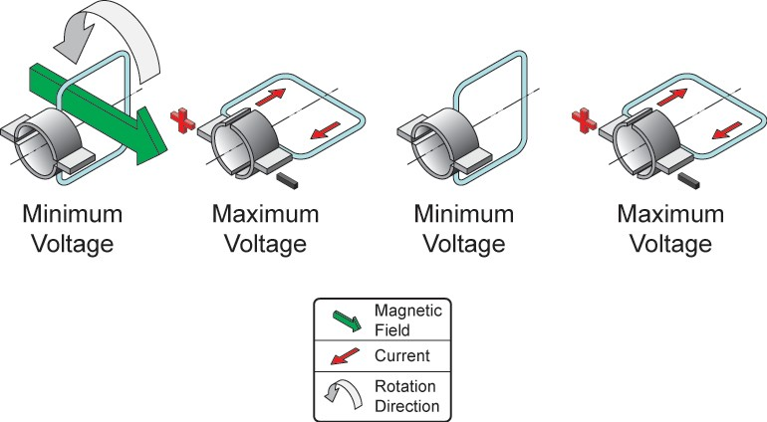
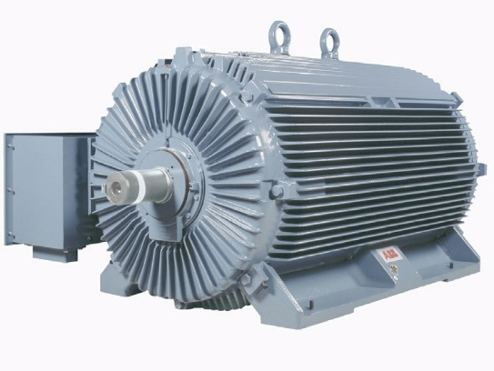
Alternators & Generators
Permanent magnet (PM) generators
PM generators are synchronous. In other words, their output frequency depends upon rotational speed.
Output voltage can vary with the load, so voltage regulation is often provided electronically. PM generators are commonly used to produce DC power.
Squirrel-cage induction generators are asynchronous.
Output frequency is not dependent upon rotational speed. They are low cost, very reliable, and have a well regulated output. Three-phase types are most economical for grid-connected AC power generation. Phase balancing with passive electronics permits single-phase grid operation also.
The solar/wind energy training system uses a PM generator to create three-phase power that is rectified to a single DC output, and is voltage regulated by internal circuitry.

Slide 17
Wind Turbine
Cut-in Speed
Cut-in speed is the minimum wind speed at which the wind turbine will generate usable power. This wind speed is typically between 7 and 15 mph.
Rated Speed
The rated speed is the minimum wind speed at which the wind turbine will generate its designated rated power. For example, a "10 kilowatt" wind turbine may not generate 10 kilowatts until wind speeds reach 25 mph. Rated speed for most machines is in the range of 25 to 35 mph. At wind speeds between cut-in and rated, the power output from a wind turbine increases as the wind increases. The output of most machines levels off above the rated speed. Most manufacturers provide graphs, called "power curves," showing how their wind turbine output varies with wind speed.

Slide 18
Wind Turbine
Cut-out Speed
At very high wind speeds, typically between 45 and 80 mph, most wind turbines cease power generation and shut down. The wind speed at which shut down occurs is called the cut-out speed. Having a cut-out speed is a safety feature which protects the wind turbine from damage. Shut down may occur in one of several ways. In some machines an automatic brake is activated by a wind speed sensor. Some machines twist or "pitch" the blades to spill the wind. Still others use "spoilers," drag flaps mounted on the blades or the hub which are automatically activated by high rotor rpm's, or mechanically activated by a spring loaded device which turns the machine sideways to the wind stream. Normal wind turbine operation usually resumes when the wind drops back to a safe level.

Slide 19
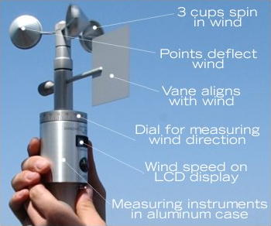
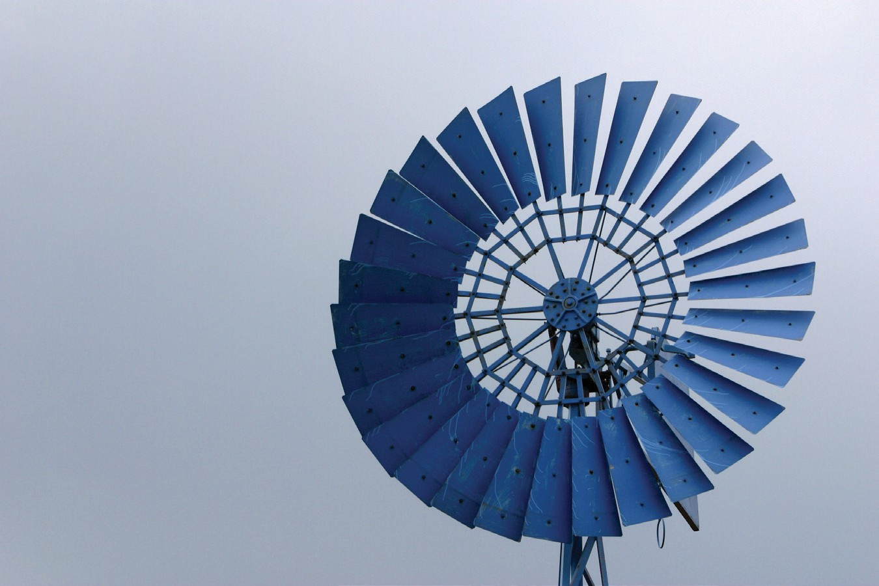
Wind Turbine
Blade designs operate on either the principle of drag or lift.
Drag Design
For the drag design, the wind literally pushes the blades out of the way.
Drag powered wind turbines are characterized by slower rotational speeds and high torque capabilities.

Slide 20
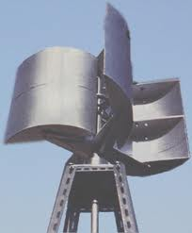
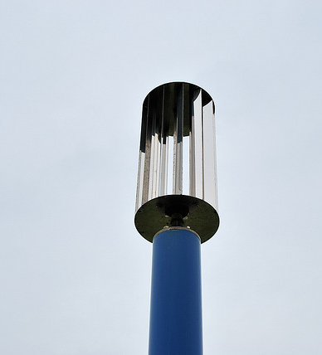
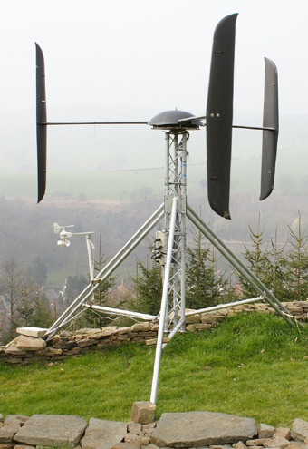
Wind Turbine Design using Drag Principle

Slide 21
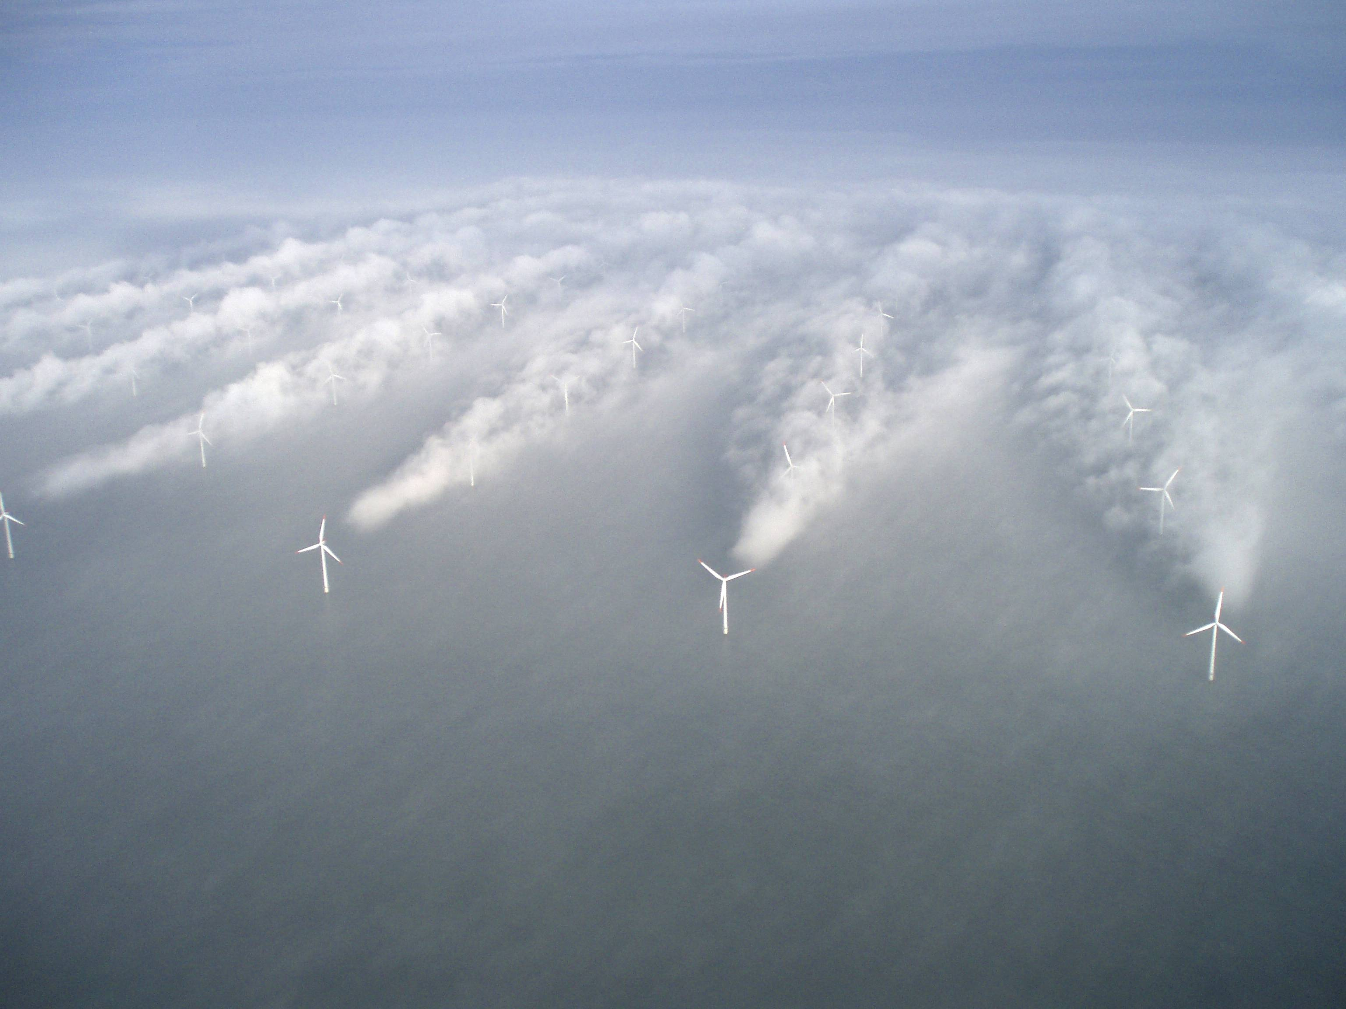
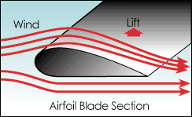
Wind Turbine
Lift Design
Airplane propeller technology
When air flows past the blade, a wind speed and pressure differential is created between the upper and lower blade surfaces.
The pressure at the lower surface is greater and thus acts to "lift" the blade. When blades are attached to a central axis, like a wind turbine rotor, the lift is translated into rotational motion.
Lift-powered wind turbines have much higher rotational speeds than drag types and therefore are well suited for electricity generation.

Slide 22
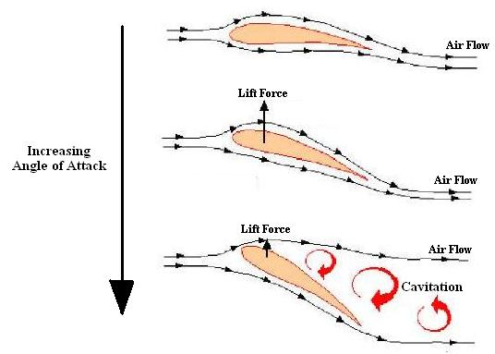
Angle of attack

Slide 23
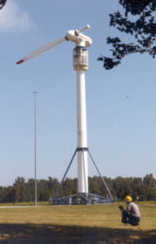
Wind Turbine – Blade Design
Blade Number
The determination of the number of blades involves design considerations of aerodynamic efficiency, component costs, system reliability, and aesthetics..
Aerodynamic efficiency increases with the number of blades but with diminishing return.
Increasing the number of blades from one to two yields a 6% increase in efficiency, whereas increasing the blade count from two to three yields only an additional 3% in efficiency. Further increasing the blade count yields minimal improvements in aerodynamic efficiency and sacrifices too much in blade stiffness as the blades become thinner.
Generally, the fewer the number of blades, the lower the material and manufacturing costs will be. Higher rotational speed reduces the torques in the drive train, resulting in lower gearbox and generator costs.
One blade rotor

Slide 24
Wind Turbine – Blade Design
The ideal wind turbine design is not dictated by technology alone, but by a combination of technology and economics: Wind turbine manufacturers wish to optimize their machines:
Deliver lowest possible cost per kilowatt hour (kWh) of energy.
Wind turbines are built to catch the wind's kinetic (motion) energy.
More blades = more torque, slower speed
Alternator wants relatively high speed and DEFINITELY steady rotation
Turbines with many blades or very wide blades will be subject to very large forces, when the wind blows at a hurricane speed.

Slide 25
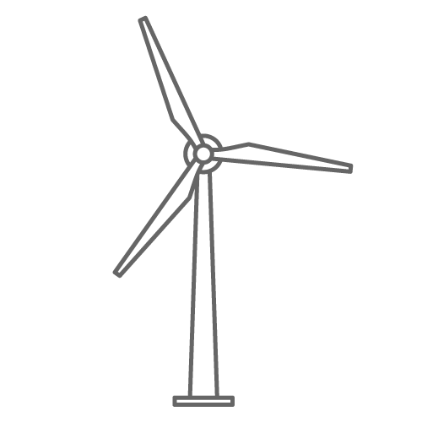
Wind Turbine – Blade Design
Even or Odd Number of Blades
A rotor with an even number of blades will cause stability problems for a wind turbine. The reason is that at the very moment when the uppermost blade bends backwards, because it gets the maximum power from the wind, the lower most blade passes into the wind shade in front of the tower. This produces uneven forces on the rotor shaft and rotor blade.

Slide 26
Wind Turbine – Blade Design (Shape)
Rotor blades for wind turbines are always twisted.
Seen from the rotor blade, the wind will be coming from a much steeper angle (more from the general wind direction in the landscape), as you move towards the root of the blade, and the center of the rotor.
A rotor blade will stop giving lift (stall), if the blade is hit at an angle of attack which is too steep.
An optimal angle of attack throughout the length of the blade is achieved by twisting.

Slide 27
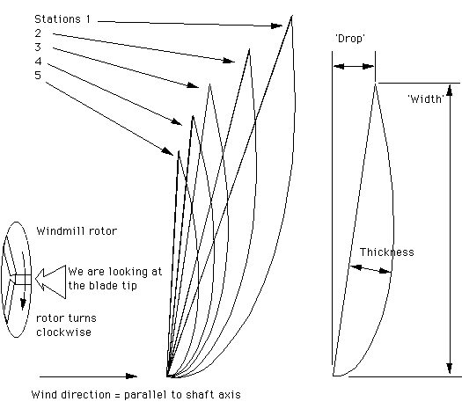
Wind Turbine – Blade Design
Blade size and shape
Last profile next to the hub
5-station design as seen from the tip
First profile at the tip

Slide 28
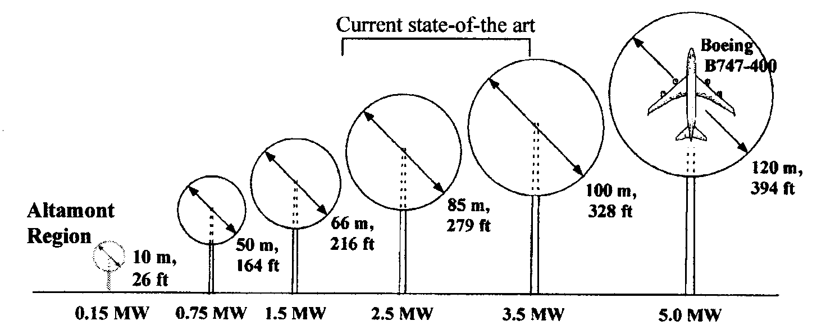
Power Generated by Wind Turbine
Swept area
Diameter
Elevation
Due to air flow restriction and turbulence, a turbine with fewer blades is usually more effective than a turbine with many blades. Using many blades makes it more difficult to control balance and harmonic vibrations, which can result in excessive noise and premature failure of wind turbine parts.
Notes:
Start 2/20

Slide 29
Theoretical Power Generated by Wind Turbine
Power = ½ (ρ)(A)(V)³
ρ = Density of air = 1.2 kg/m³ (.0745 lb/ft³), at sea level, 20 ºC and dry air
A = swept area = π(radius)², m²
V = Wind Velocity, m/sec.
ρ = 1.275 kg/m³ at standard temperature and pressure. The average wind velocity is 5 mph at 50m tower height (example)
ρ = 1.2 kg/m³, at 1000 feet elevation
ρ = 1.25 kg/m³ , at 100 feet elevation and average wind velocity of 10 m/s at 50m tower height (turbines need a minimum of 6.25 m/s wind velocity to generate power).
Notes:
Start

Slide 30
Wind Turbine Efficiency, η
The most energy that can be converted from the wind into electricity is a theoretical value of 59%, called the Betz limit.
However, many modern turbines run at only about half of this value due to mechanical and thermal losses, and other inefficiencies, such as electromagnetic losses in the generator stage. Emerging technologies are helping to constantly improve the efficiency of wind turbine generators.
If the blades were 100% efficient, a wind turbine would not work because the air, having given up all its energy, would entirely stop. In practice, the collection efficiency of a rotor is not as high as 59%. A more typical efficiency is 35% to 45%.
A complete wind energy system, including rotor, transmission, generator, storage and other devices, which all have less than perfect efficiencies, will deliver between 10% and 30% of the original energy available in the wind.
Betz Limit

Slide 31
Power Generated by Wind Turbines
How much power can a wind turbine with a 50 meter blade generate with a wind speed of 12 m/s? The site of the installation is about 100 feet above sea level. Assume 40% efficiency (η).
Air density is lower at higher elevation. For 100 feet above sea level, ρ is about 1.16 kg/m³
Power = ½ (ρ)(A)(V)³ (η)
= 0.5(1.16)(π50²)(12)³(0.4)
= 3.15 x 10⁶ Watt
= 3.15 MW
where we assumed the turbine efficiency is 40%.

Slide 32
Question
Why do turbine blades have a “twisted’ shape?
Looks cool
More aerodynamic
Easy to remove from the mold
Less weight near the tip of the blade.
Keep angle of attack same along the blade

Slide 33
Wind Turbine
Tip Speed Ratio
The tip-speed ratio is the ratio of the rotational speed of the blade to the wind speed. The larger this ratio, the faster the rotation of the wind turbine rotor at a given wind speed. Electricity generation requires high rotational speeds. Lift-type wind turbines have maximum tip-speed ratios of around 10, while drag-type ratios are approximately 1. Given the high rotational speed requirements of electrical generators, it is clear that the lift-type wind turbine is the most practical for this application.
The number of blades and the total area they cover affect wind turbine performance. For a lift-type rotor to function effectively, the wind must flow smoothly over the blades. To avoid turbulence, spacing between blades should be great enough so that one blade will not encounter the disturbed, weaker air flow caused by the blade which passed before it.

Slide 34
Power Generated by Wind Turbine
Wind turbines with rotors (turbine blades and hub) that are about 8 feet in diameter (50 square feet of swept area) may peak at about 1,000 watts (1 kilowatt; kW), and generate about 75 kilowatt-hours (kWh) per month with a 10 mph average wind speed. Turbines smaller than this may be appropriate for sailboats, cabins, or other applications that require only a small amount of electricity. [Small Wind]
For wind turbine farms, it’s reasonable to use turbines with rotors up to 56 feet in diameter (2,500 square feet of swept area). These turbines may peak at about 90,000 watts (90 kW), and generate 3,000 to 5,000 kWh per month at a 10 mph average wind speed, enough to supply 200 homes with electricity.
Homes typically use 500-1,500 kilowatt-hours of electricity per month. Depending upon the average wind speed in the area this will require a wind turbine rated in the range 5-15 kilowatts, which translates into a rotor diameter of 14 to 26 feet.

Slide 35
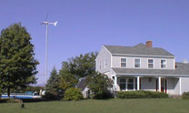
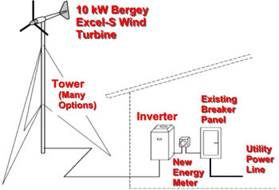
Example Residential Wind Turbine
Bergey wind turbines operate at variable speed to optimize performance and reduce structural loads. Power is generated in a direct drive, low speed, permanent magnet alternator. The output is a 3-phase power that varies in both voltage and frequency with wind speed. This variable power (wild AC) is not compatible with the utility grid. To make it compatible, the wind power is converted into grid-quality 240 VAC, single phase, 60 hertz power in an IGBT-type synchronous inverter, the GridTek Power Processor. The output from the GridTek can be directly connected to the home or business circuit breaker panel. Operation of the system is fully automatic. It has a rotor diameter of 23 feet and is typically installed on 80 or 100 foot towers.
10kW Turbine | $27,900
100 ft.Tower Kit | $9,200
Tower Wiring Kit | $1,000
Total Cost: | $38,100

Slide 36
Wind Turbine
Doubling the tower height increases the expected wind speeds by 10% and the expected power by 34%. Doubling the tower height generally requires doubling the diameter as well, increasing the amount of material by a factor of eight.
At night time, or when the atmosphere becomes stable, wind speed close to the ground usually subsides whereas at turbine altitude, it does not decrease that much or may even increase. As a result, the wind speed is higher and a turbine will produce more power than expected - doubling the altitude may increase wind speed by 20% to 60%.
Tower heights approximately two to three times the blade length have been found to balance material costs of the tower against better utilization of the more expensive active components.

Slide 37
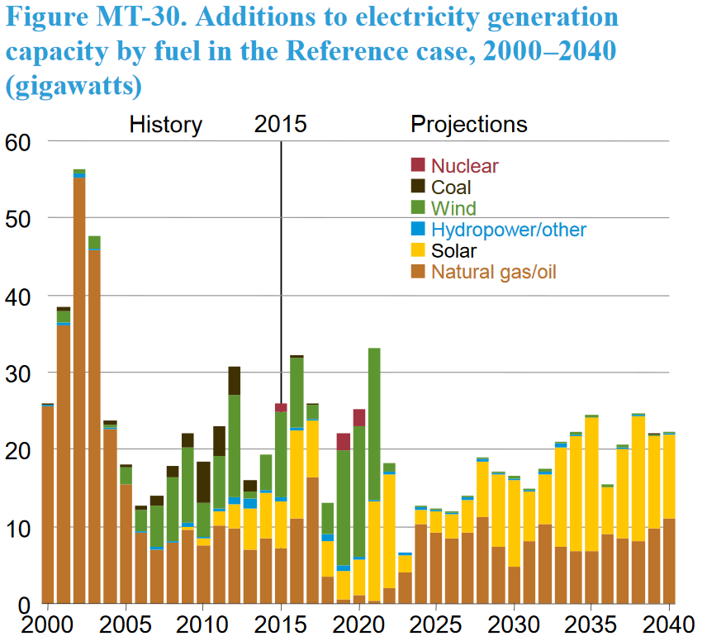
Source: EIA, Annual Energy Outlook 2016
24%
10%
45%

Slide 38
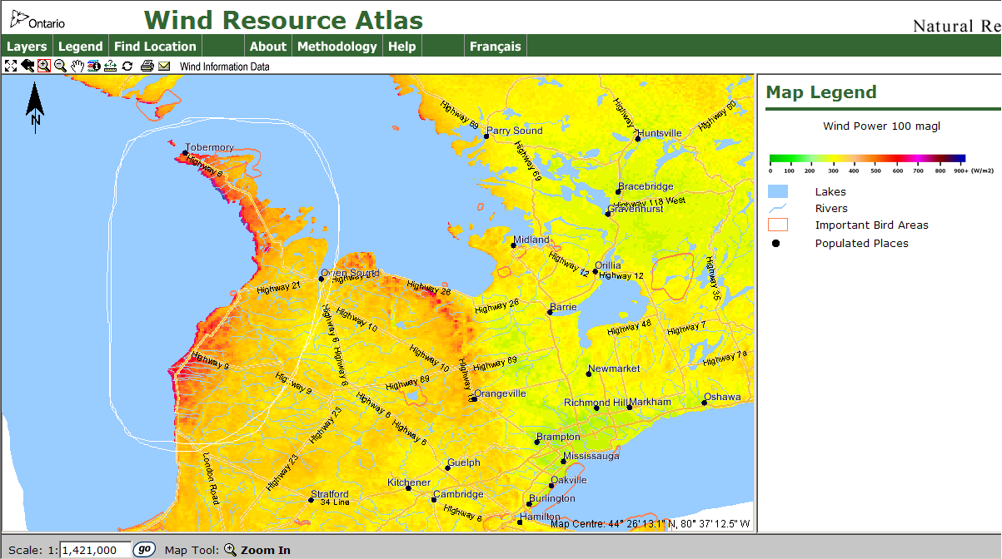
Where is the Wind?

